Slide 1
A Climate Science Update
Raymond Najjar
Professor of Oceanography, Penn State, rgn1@psu.edu
Centre County Democrats
Leadership Circle Summer Reception
June 20, 2023

Slide 2
What I chose to discuss in 20 minutes
Human contribution to climate change
Some recent unusual events
Emissions: how they are changing and who’s responsible
Past environmental successes

Slide 3
We cannot explain observed warming with natural drivers …
1951–1980 average
Fourth National Climate Assessment, Hayhoe et al. (2018)
Notes:
Hayhoe, K., Wuebbles, D.J., Easterling, D.R., Fahey, D.W., Doherty, S., Kossin, J., Sweet, W., Vose, R., Wehner, M., 2018. Our changing climate. In: D.R. Reidmiller, C.W. Avery, D.R. Easterling, K.E. Kunkel, K.L.M. Lewis, T.K. Maycock, B.C. Stewart (Editors), Impacts, Risks, and Adaptation in the United States: Fourth National Climate Assessment. US Global Change Research Program, Washington, DC, USA, pp. 72–144.

Slide 4
… but we can with human drivers
1951–1980 average
Fourth National Climate Assessment, Hayhoe et al. (2018)
Notes:
Hayhoe, K., Wuebbles, D.J., Easterling, D.R., Fahey, D.W., Doherty, S., Kossin, J., Sweet, W., Vose, R., Wehner, M., 2018. Our changing climate. In: D.R. Reidmiller, C.W. Avery, D.R. Easterling, K.E. Kunkel, K.L.M. Lewis, T.K. Maycock, B.C. Stewart (Editors), Impacts, Risks, and Adaptation in the United States: Fourth National Climate Assessment. US Global Change Research Program, Washington, DC, USA, pp. 72–144.

Slide 5
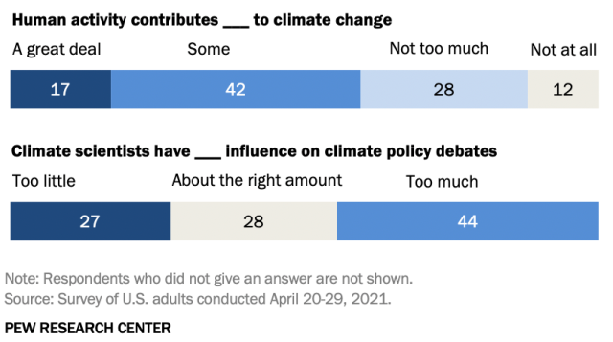
Republicans think otherwise
% of Republicans and Republican leaners who say …
Notes:
https://www.pewresearch.org/short-reads/2021/07/23/on-climate-change-republicans-are-open-to-some-policy-approaches-even-as-they-assign-the-issue-low-priority/

Slide 6
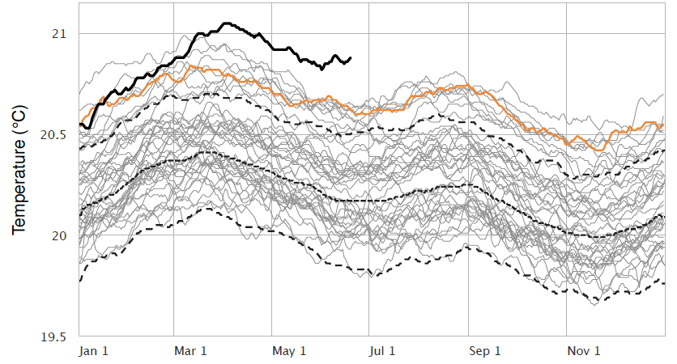
The ocean surface is extremely warm now
Each line represents a year of global average sea surface temperature since 1981
2023
2022
Notes:
https://climatereanalyzer.org/clim/sst_daily/

Slide 7
Some of it is El Niño, but the North Atlantic is a big surprise
Notes:
https://climatereanalyzer.org/clim/sst_daily/

Slide 8
Sea ice declines have long been a worry in the Arctic, but now the Antarctic is also a concern
June 19, 2023 sea ice cover
Source: National Snow and Ice Data Center
Notes:
https://nsidc.org/arcticseaicenews/

Slide 9
Emissions: Who’s responsible?
What Nikki Haley recently said in the CNN Town Hall:
“If we want to really fix the environment, then let’s start having serious conversations with India and China. They are our polluters. They’re the ones that are causing the problem.”

Slide 10
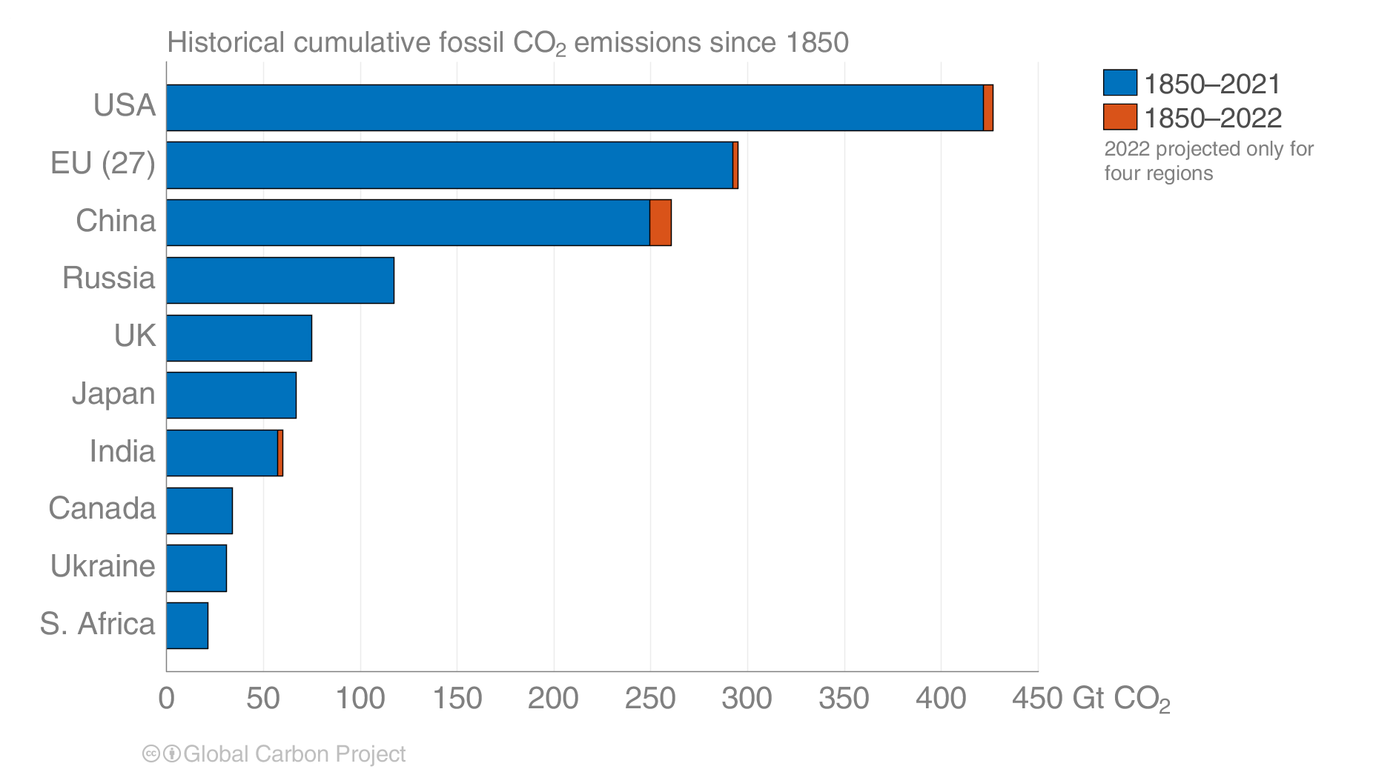
The US is the biggest historical contributor to CO₂ emissions
Source: Global Carbon Budget 2022

Slide 11
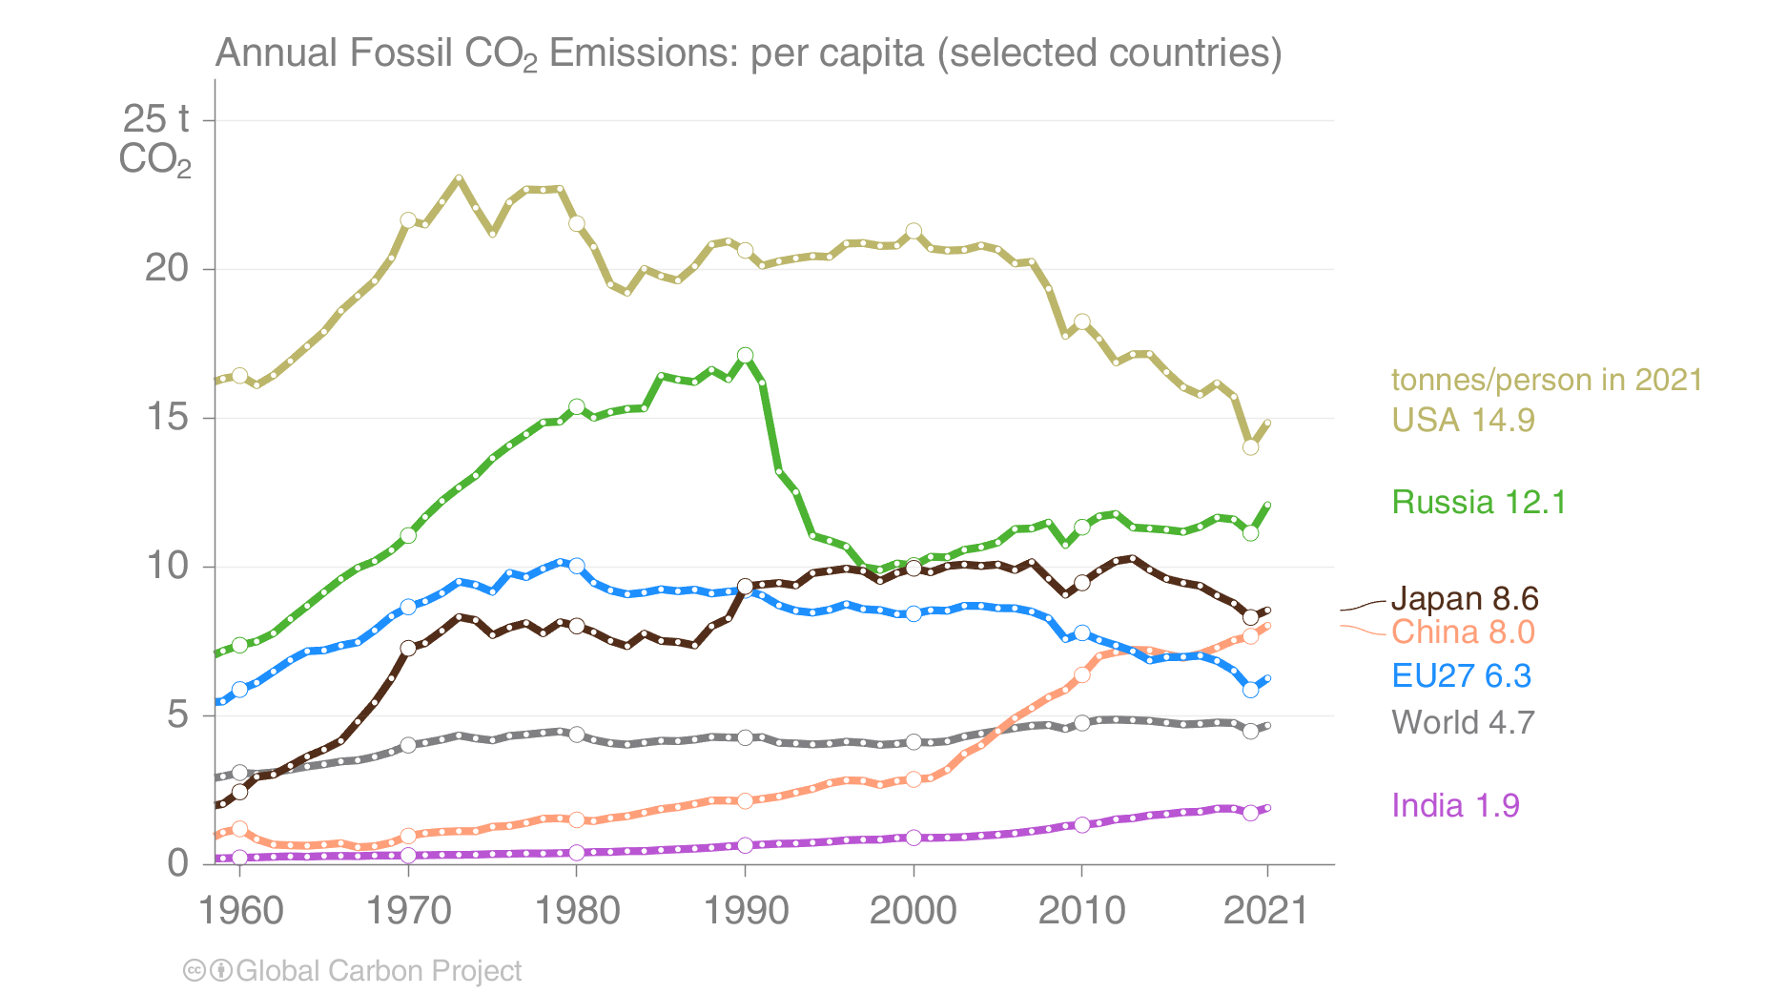
The US is also the largest per capita contributor to CO₂ emissions
Source: Global Carbon Budget 2022

Slide 12
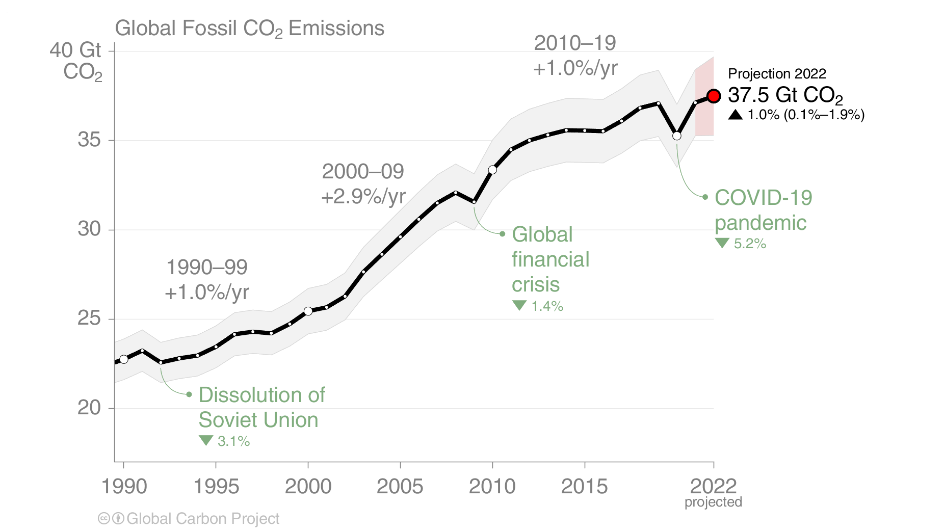
Are we nearing peak emissions?
Source: Global Carbon Budget 2022

Slide 13
A local advance
“With a goal of achieving 100% greenhouse gas emissions reduction by 2035, Penn State — under the direction of President Neeli Bendapudi — is moving forward with several of the recommendations presented by the University’s Carbon Emissions Reduction Task Force in spring 2022”
“Penn State has already reduced its GHG emissions by 42% since 2005”
Source: Penn State
Notes:
https://www.psu.edu/news/administration/story/president-bendapudi-addresses-climate-action/

Slide 14
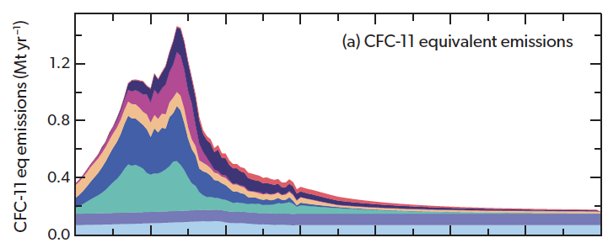
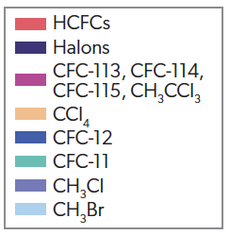
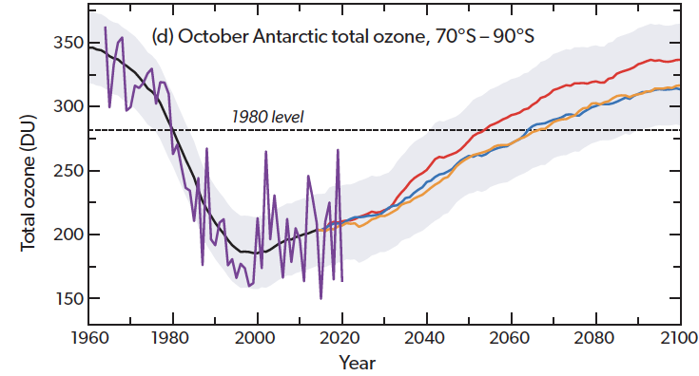
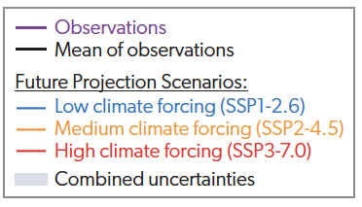
The ozone layer is recovering because we reduced CFC emissions
Source: World Meteorological Organization
Notes:
World Meteorological Organization (WMO). Executive Summary. Scientific Assessment of Ozone Depletion: 2022,
GAW Report No. 278, 56 pp.; WMO: Geneva, 2022.

Slide 15
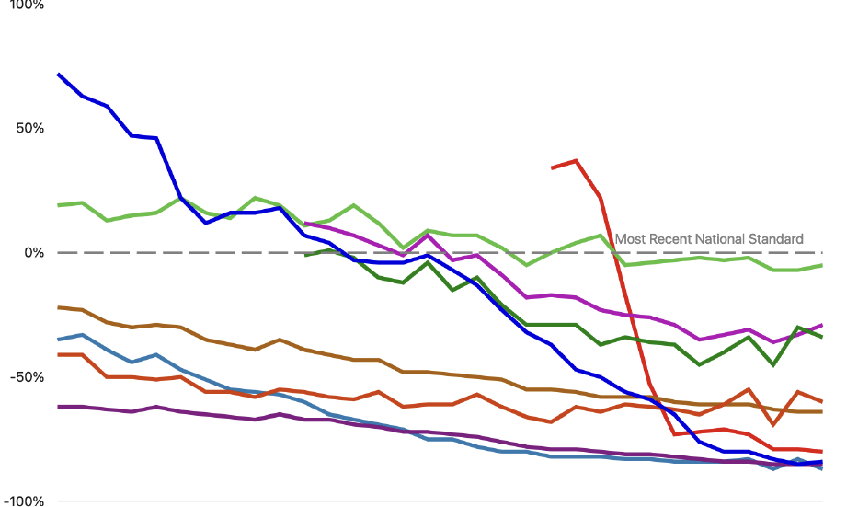
US air quality has improved dramatically over the past 30 years
100%
Sulfur dioxide
50%
Lead
Ozone
0%
Percent above or below standard
Nitrogen dioxide (1-hour)
PM-2.5
–50%
Nitrogen dioxide
(annual)
Carbon monoxide
–100%
1990
2000
2010
2020
Source: US EPA
Notes:
https://gispub.epa.gov/air/trendsreport/2022/#introduction

