Slide 1
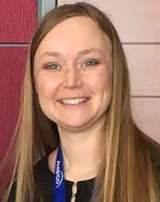
Department of Meteorology and Atmospheric Science
Spring 2025 Colloquium
“ ”
Becky Adams-Selin
Senior Science Manager
Verick Atmospheric and Environmental Research
Wednesday, April 9, 2025
3:30 – 4:30 p.m.
Zoom Webinar

