Slide 1
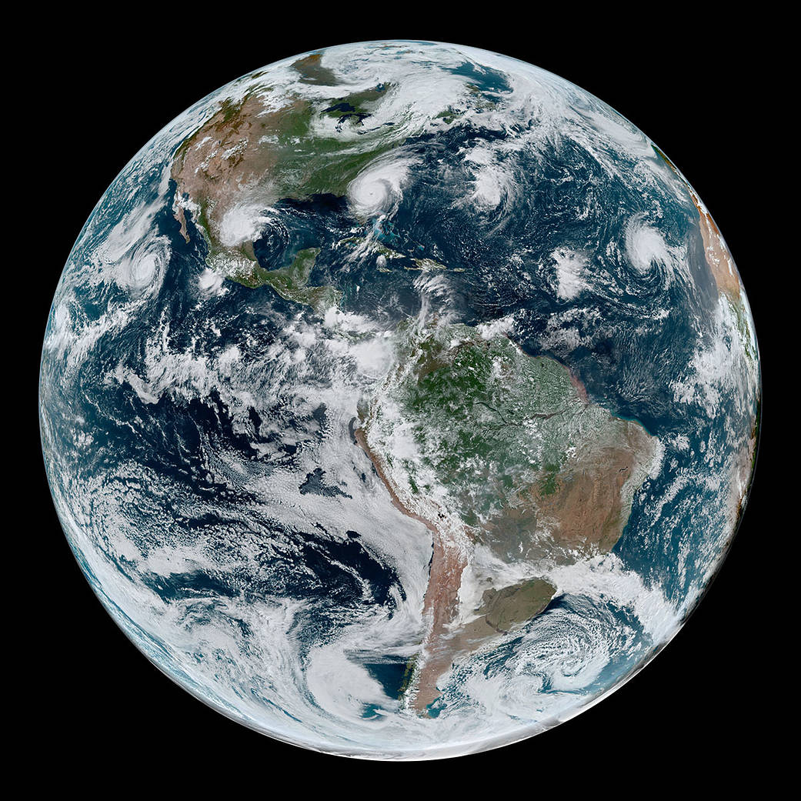
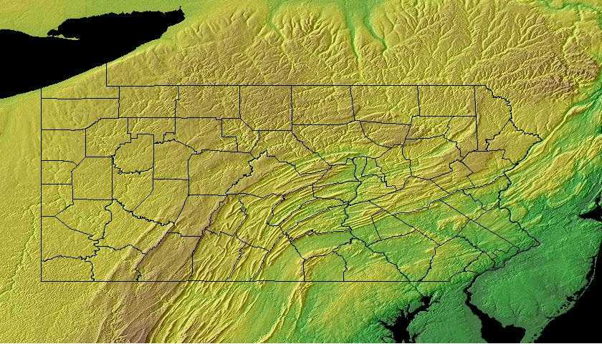
Managing the threats of climate change in Pennsylvania
Raymond Najjar
The Pennsylvania State University
Mifflin County Public Library
November 12, 2019
Notes:
https://www.nasa.gov/topics/earth/images/index.html
Geology.com

Slide 2
We cannot explain observed warming with natural drivers …
1951–1980 average
Fourth National Climate Assessment, Hayhoe et al. (2018)
Notes:
Hayhoe, K., Wuebbles, D.J., Easterling, D.R., Fahey, D.W., Doherty, S., Kossin, J., Sweet, W., Vose, R., Wehner, M., 2018. Our changing climate. In: D.R. Reidmiller, C.W. Avery, D.R. Easterling, K.E. Kunkel, K.L.M. Lewis, T.K. Maycock, B.C. Stewart (Editors), Impacts, Risks, and Adaptation in the United States: Fourth National Climate Assessment. US Global Change Research Program, Washington, DC, USA, pp. 72–144.

Slide 3
… but we can with human drivers
1951–1980 average
Fourth National Climate Assessment, Hayhoe et al. (2018)
Notes:
Hayhoe, K., Wuebbles, D.J., Easterling, D.R., Fahey, D.W., Doherty, S., Kossin, J., Sweet, W., Vose, R., Wehner, M., 2018. Our changing climate. In: D.R. Reidmiller, C.W. Avery, D.R. Easterling, K.E. Kunkel, K.L.M. Lewis, T.K. Maycock, B.C. Stewart (Editors), Impacts, Risks, and Adaptation in the United States: Fourth National Climate Assessment. US Global Change Research Program, Washington, DC, USA, pp. 72–144.

Slide 4


The greenhouse effect in three steps
1. Solar radiation warms Earth
2. Earth’s radiation absorbed in atmosphere
3. Atmosphere’s radiation further warms Earth—by 60 ºF

Slide 5
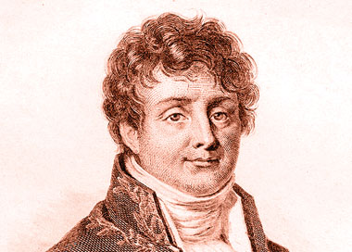
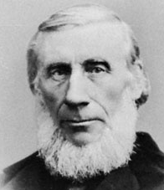
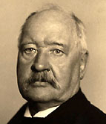
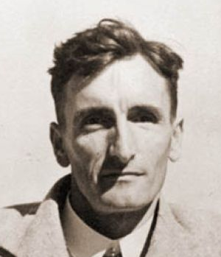
The greenhouse effect is well established
1824: Joseph Fourier describes natural greenhouse effect
1858–1861: Eunice Foote and John Tyndall identify greenhouse gases
1896: Svante Arrenhius estimates greenhouse effect of fossil fuel CO₂
1938: Guy Callendar documents warming and CO₂ increase

Slide 6
“Many lines of evidence demonstrate that it is extremely likely that human influence has been the dominant cause of the observed warming since the mid-20th century.”
“For the period extending over the last century, there are no convincing alternative explanations supported by the extent of the observational evidence.”
Fourth National Climate Assessment, Wuebbles et al. (2017)
Notes:
Wuebbles, D.J., Easterling, D.R., Hayhoe, K., Knutson, T., Kopp, R.E., Kossin, J.P., Kunkel, K.E., LeGrande, A.N., Mears, C., Sweet, W.V., Taylor, P.C., Vose, R.S., Wehner, M.F., 2017. Our globally changing climate. In: D.J. Wuebbles, D.W. Fahey, K.A. Hibbard, D.J. Dokken, B.C. Stewart, T.K. Maycock (Editors), Climate Science Special Report: Fourth National Climate Assessment, Volume I. U.S. Global Change Research Program, Washington, DC, USA, pp. 35–72.

Slide 7
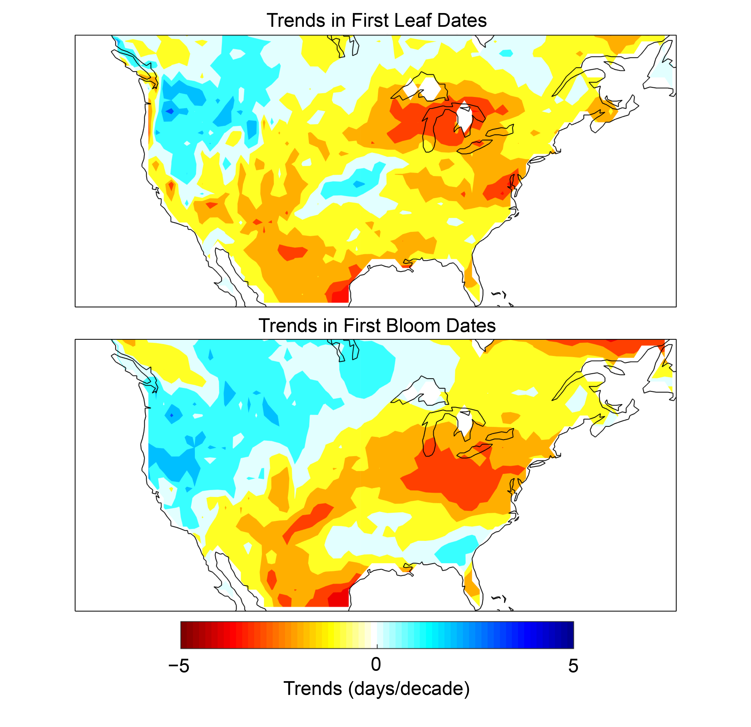
Plants are leafing out and blooming earlier
1981–2010 trends of three indicator plants
First leaf First bloom
Fourth National Climate Assessment, Lipton et al. (2018)
Notes:
Lipton, D., M. A. Rubenstein, S.R. Weiskopf, S. Carter, J. Peterson, L. Crozier, M. Fogarty, S. Gaichas, K.J.W. Hyde, T.L. Morelli, J. Morisette, H. Moustahfid, R. Muñoz, R. Poudel, M.D. Staudinger, C. Stock, L. Thompson, R. Waples, and J.F. Weltzin, 2018: Ecosystems, Ecosystem Services, and Biodiversity. In Impacts, Risks, and Adaptation in the United States: Fourth National Climate Assessment, Volume II [Reidmiller, D.R., C.W. Avery, D.R. Easterling, K.E. Kunkel, K.L.M. Lewis, T.K. Maycock, and B.C. Stewart (eds.)]. U.S. Global Change Research Program, Washington, DC, USA, pp. 268–321. doi: 10.7930/NCA4.2018.CH7

Slide 8
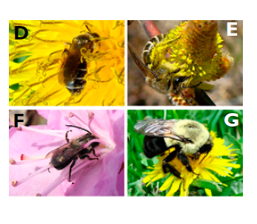
Native bees in Northeast US are arriving in spring 10 days earlier than they used to
A. miserabilis
C. inaequalis
O. lignaria
B. impatiens
Bartomeus et al. (2011)
Notes:
Bartomeus, I., Ascher, J.S., Wagner, D., Danforth, B.N., Colla, S., Kornbluth, S., Winfree, R., 2011. Climate-associated phenological advances in bee pollinators and bee-pollinated plants. Proceedings of the National Academy of Sciences 108, 20645-20649.

Slide 9
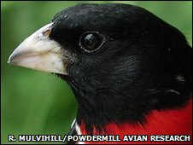
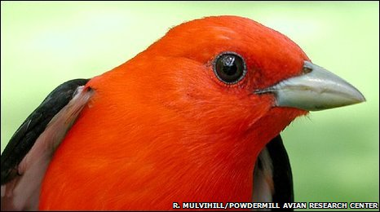
Birds in Western PA became smaller by 1.3% on average due to warming from 1961 to 2007
Scarlet tanager: 2% smaller
Rose-breasted grossbeak: 2% smaller
Van Buskirk et al. (2009, 2010)
Notes:
Van Buskirk, J., Mulvihill, R.S., Leberman, R.C., 2010. Declining body sizes in North American birds associated with climate change. Oikos 119, 1047-1055.
Van Buskirk, J., Mulvihill, R.S., Leberman, R.C., 2009. Variable shifts in spring and autumn migration phenology in North American songbirds associated with climate change. Global Change Biology 15, 760-771.

Slide 10
The ratio of snow to total precipitation is mostly decreasing in the Northeast US
1949–2005 trend
Decreasing
Increasing
Feng and Hu (2007)
Notes:
Feng, S., Hu, Q., 2007. Changes in winter snowfall/precipitation ratio in the contiguous United States. Journal of Geophysical Research: Atmospheres 112, doi: 10.1029/2007jd008397.

Slide 11
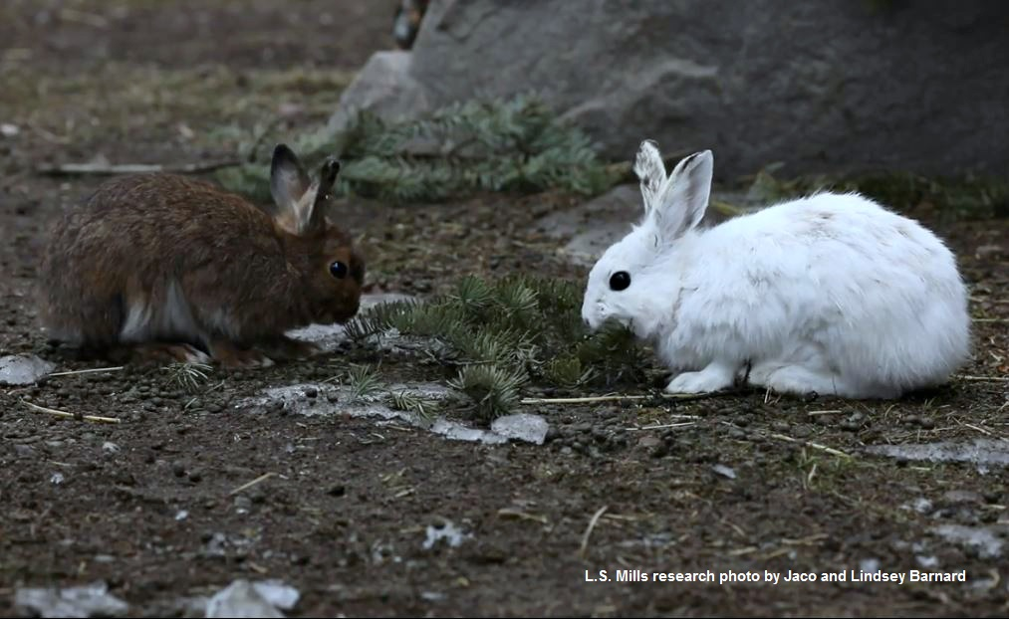
With warming and snowpack reduction, Snowshoe Hare range in Pennsylvania has contracted
Diefenbach et al. (2016), Fourth National Climate Assessment (Lipton et al. 2018)
Notes:
Diefenbach, D.R., Rathbun, S.L., Vreeland, J.K., Grove, D., Kanapaux, W.J., 2016. Evidence for range contraction of snowshoe hare in Pennsylvania. Northeastern Naturalist 23, 229-249.
Lipton, D., M. A. Rubenstein, S.R. Weiskopf, S. Carter, J. Peterson, L. Crozier, M. Fogarty, S. Gaichas, K.J.W. Hyde, T.L. Morelli, J. Morisette, H. Moustahfid, R. Muñoz, R. Poudel, M.D. Staudinger, C. Stock, L. Thompson, R. Waples, and J.F. Weltzin, 2018: Ecosystems, Ecosystem Services, and Biodiversity. In Impacts, Risks, and Adaptation in the United States: Fourth National Climate Assessment, Volume II [Reidmiller, D.R., C.W. Avery, D.R. Easterling, K.E. Kunkel, K.L.M. Lewis, T.K. Maycock, and B.C. Stewart (eds.)]. U.S. Global Change Research Program, Washington, DC, USA, pp. 268–321. doi: 10.7930/NCA4.2018.CH7
Photo credit: L. S. Mills research photo by Jaco and Lindsey Barnard, University of Montana Mills Research Lab.

Slide 12
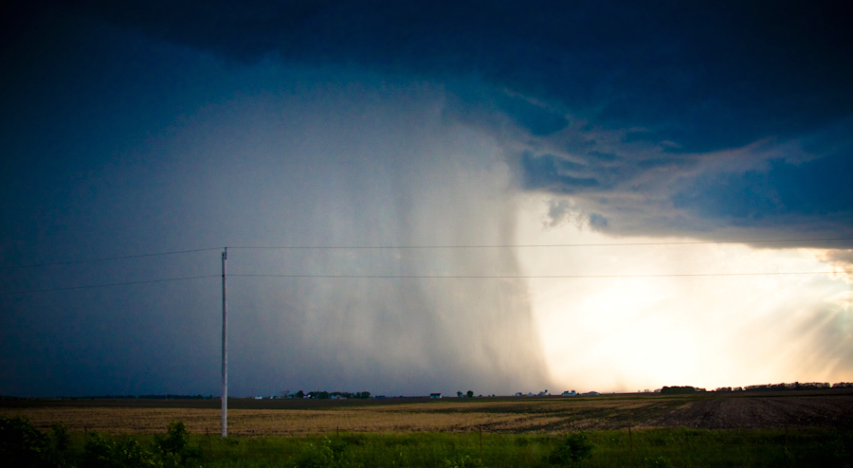
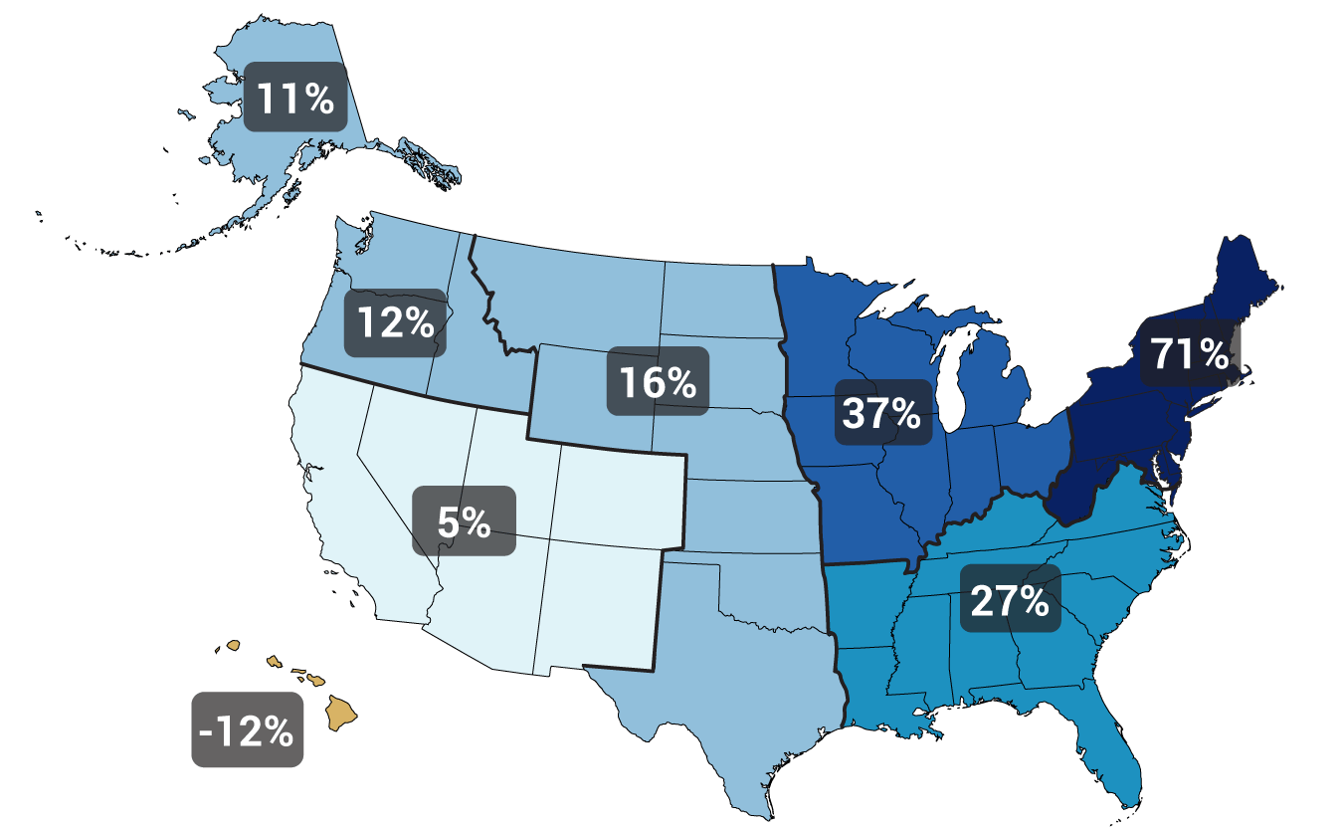
Heavy precipitation is increasing
Gustoflight.wordpress.com
Change in top 1% of rainiest days from 1958 to 2012
Walsh et al. (2014)
Notes:
Walsh, J., Wuebbles, D., Hayhoe, K., Kossin, J., Kunkel, K., Stephens, G., Thorne, P., Vose, R., Wehner, M., Willis, J., Anderson, D., Doney, S., Feely, R., Hennon, P., Kharin, V., Knutson, T., Landerer, F., Lenton, T., Kennedy, J., Somerville, R., 2014. Chapter 2: Our Changing Climate. In: J.M. Melillo, T.C. Richmond, G.W. Yohe (Editors), Climate Change Impacts in the United States: The Third National Climate Assessment. U.S. Global Change Research Program, pp. 19-67.

Slide 13
Three possible emissions futures …
Fourth National Climate Assessment, Wuebbles et al. (2017)
Notes:
Wuebbles, D.J., Easterling, D.R., Hayhoe, K., Knutson, T., Kopp, R.E., Kossin, J.P., Kunkel, K.E., LeGrande, A.N., Mears, C., Sweet, W.V., Taylor, P.C., Vose, R.S., Wehner, M.F., 2017. Our globally changing climate. In: D.J. Wuebbles, D.W. Fahey, K.A. Hibbard, D.J. Dokken, B.C. Stewart, T.K. Maycock (Editors), Climate Science Special Report: Fourth National Climate Assessment, Volume I. U.S. Global Change Research Program, Washington, DC, USA, pp. 35–72.

Slide 14
… lead to very different climate futures
Fourth National Climate Assessment, Wuebbles et al. (2017)
Notes:
Wuebbles, D.J., Easterling, D.R., Hayhoe, K., Knutson, T., Kopp, R.E., Kossin, J.P., Kunkel, K.E., LeGrande, A.N., Mears, C., Sweet, W.V., Taylor, P.C., Vose, R.S., Wehner, M.F., 2017. Our globally changing climate. In: D.J. Wuebbles, D.W. Fahey, K.A. Hibbard, D.J. Dokken, B.C. Stewart, T.K. Maycock (Editors), Climate Science Special Report: Fourth National Climate Assessment, Volume I. U.S. Global Change Research Program, Washington, DC, USA, pp. 35–72.

Slide 15
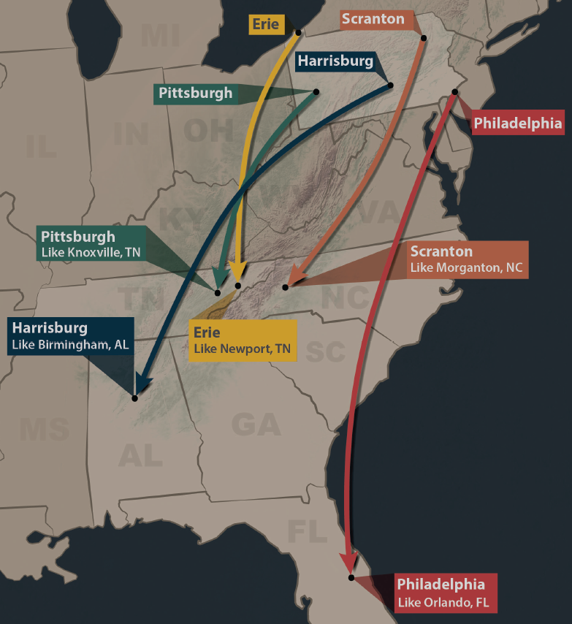
Summers in Pennsylvania will feel like those of the Southeast US by mid-century if heat trapping emissions trends continue
http://psiee.psu.edu/climate-impacts
Notes:
http://psiee.psu.edu/climate-impacts

Slide 16
Emissions really matter, especially in the long run
Union of Concerned Scientists (2008)
Notes:
Union of Concerned Scientists, 2008. Climate Change in Pennsylvania: Impacts and Solutions for the Keystone State. Cambridge, MA, 54 pp.

Slide 17
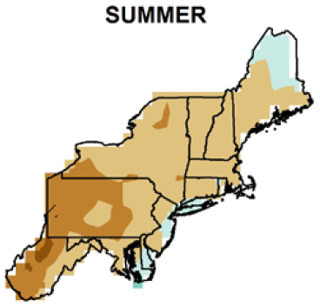
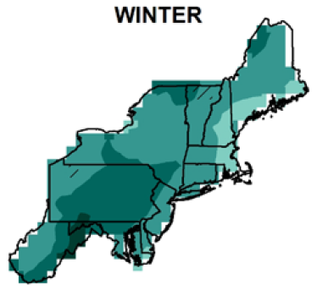

Expect summers to be drier …
… and winters to be wetter
0
8
12
-4
16
Percent precipitation change by 2050s
Kunkel et al. (2013)
Notes:
Kunkel, K.E., Stevens, L.E., Stevens, S.E., Sun, L., Janssen, E., Wuebbles, D., Rennells, J., DeGaetano, A., Dobson, J.G., 2013. Regional Climate Trends and Scenarios for the U.S. National Climate Assessment, Part 1. Climate of the Northeast U.S., NOAA Technical Report NESDIS 142-1. U.S. Department of Commerce, Washington, D.C., 79 pp.

Slide 18
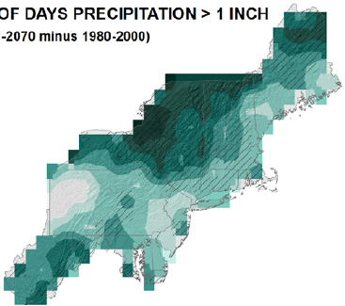

Expect heavy downpours to continue to increase
Percent change by 2050s in days > 1”
21
27
21
15
Kunkel et al. (2013)
Notes:
Kunkel, K.E., Stevens, L.E., Stevens, S.E., Sun, L., Janssen, E., Wuebbles, D., Rennells, J., DeGaetano, A., Dobson, J.G., 2013. Regional Climate Trends and Scenarios for the U.S. National Climate Assessment, Part 1. Climate of the Northeast U.S., NOAA Technical Report NESDIS 142-1. U.S. Department of Commerce, Washington, D.C., 79 pp.

Slide 19
Projected change in downhill skiing season length by 2090
Low emissions
High emissions
RCP 4.5
RCP 8.5
Wobus et al. (2017)
Notes:
Wobus, C., Small, E.E., Hosterman, H., Mills, D., Stein, J., Rissing, M., Jones, R., Duckworth, M., Hall, R., Kolian, M., 2017. Projected climate change impacts on skiing and snowmobiling: A case study of the United States. Global environmental change 45, 1-14.

Slide 20
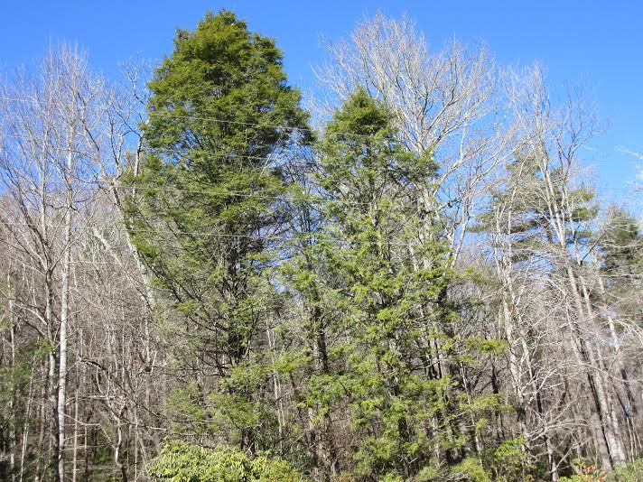
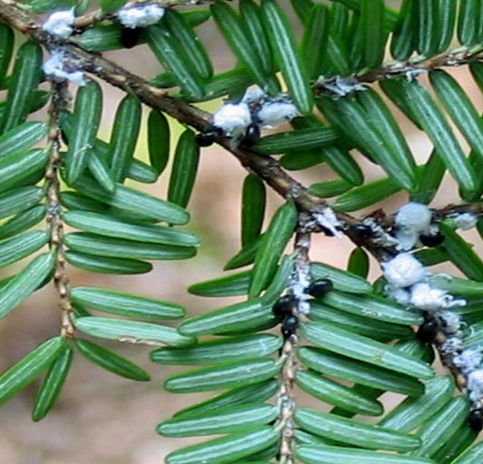
The wooly adelgid harms the Eastern Hemlock tree (PA state tree)
savinghemlocks.org

Slide 21
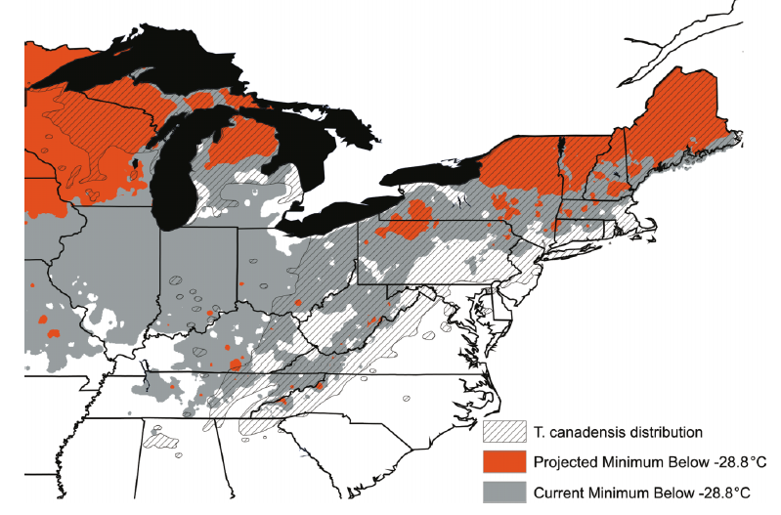
Warming winters allow the wooly adelgid to do more damage
&
Hemlock safe today
Hemlock safe in 2070
Dukes et al. (2009)
A2 scenario, 2070, average of nine GCMs
Notes:
Dukes, J.S., Pontius, J., Orwig, D., Garnas, J.R., Rodgers, V.L., Brazee, N., Cooke, B., Theoharides, K.A., Stange, E.E., Harrington, R., 2009. Responses of insect pests, pathogens, and invasive plant species to climate change in the forests of northeastern North America: What can we predict? Canadian Journal of Forest Research 39, 231-248.

Slide 22
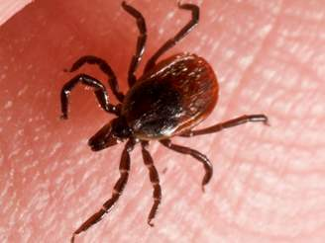
In Millbrook, NY, warming has led to an earlier larval peak of the blacklegged (deer) tick, the major Lyme disease transmitter
Earlier larval peak
Cumulative degree days through August
Warmer years
Levi et al. (2015)
Notes:
Levi, T., Keesing, F., Oggenfuss, K., Ostfeld, R.S., 2015. Accelerated phenology of blacklegged ticks under climate warming. Philosophical Transactions of the Royal Society B: Biological Sciences 370, 20130556.

Slide 23
Opportunities

Slide 24
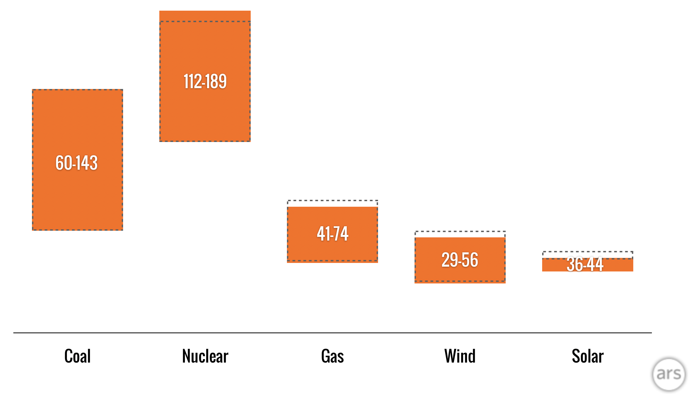
Renewables are cheap!
Costs of new installations in dollars per megawatt-hour
2018
2017
Coal Nuclear Gas Wind Solar
Notes:
https://arstechnica.com/information-technology/2018/11/new-year-same-story-cost-of-wind-and-solar-fall-below-cost-of-coal-and-gas/

Slide 25
Use of efficient light bulbs is skyrocketing …
Notes:
Department of Energy data
Graphic from NY Times: https://www.nytimes.com/interactive/2019/03/08/climate/light-bulb-efficiency.html

Slide 26
… and reducing electricity costs
Notes:
Department of Energy data
Graphic from NY Times: https://www.nytimes.com/interactive/2019/03/08/climate/light-bulb-efficiency.html

Slide 27
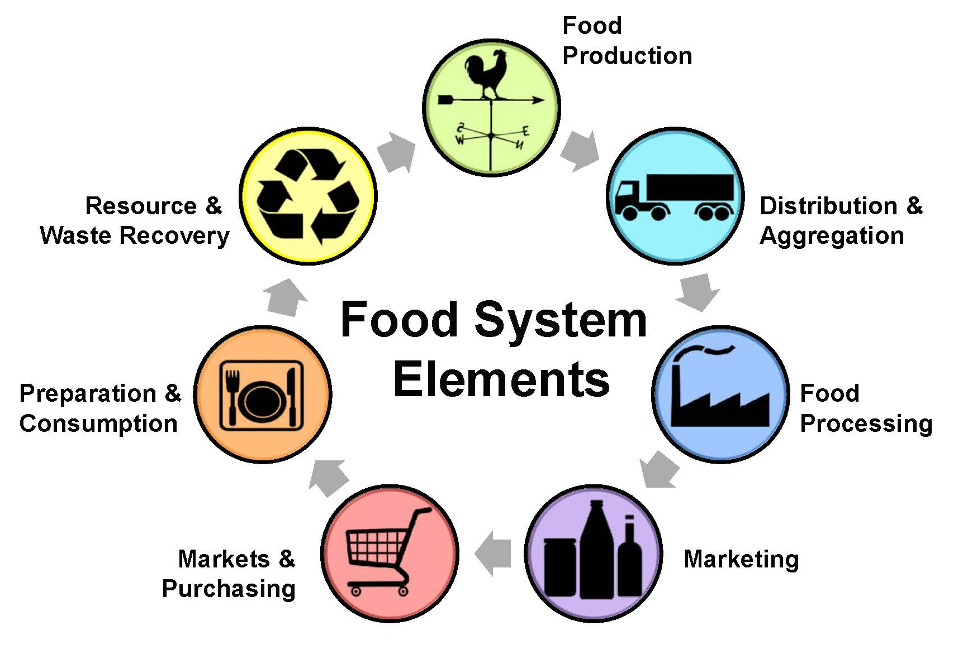
Food systems are responsible for one-quarter of greenhouse gas emissions
Notes:
http://lfs-teg-collab.sites.olt.ubc.ca/files/2015/12/Slide5.jpg

Slide 28
Your diet matters!
Kilograms of CO₂ equivalent released in production and consumption of 50 grams of protein
Graphic: NY Times
Notes:
Poore, J., Nemecek, T., 2018. Reducing food’s environmental impacts through producers and consumers. Science 360, 987-992.
Graphic: https://www.nytimes.com/interactive/2019/04/30/dining/climate-change-food-eating-habits.html

Slide 29
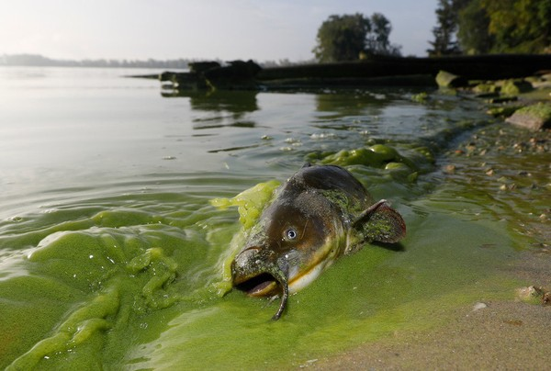
Less fossil fuel, less nitrogen pollution, fewer harmful algal blooms, fewer dead zones
Notes:
https://www.cleveland.com/metro/2017/10/lake_erie_algal_bloom_cleanup_1.html

Slide 30
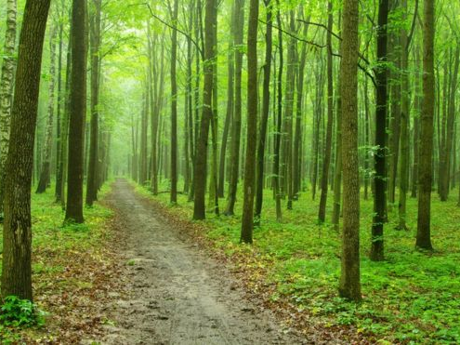
$4.32 per person per year in Medicare savings for every 1% increase in forest cover
Up to $9 billion in savings per year for the US
Notes:
Douglas A. Becker, Matthew H.E.M. Browning, Ming Kuo, Stephen K. Van Den Eeden. Is green land cover associated with less health care spending? Promising findings from county-level Medicare spending in the continental United States. Urban Forestry & Urban Greening, 2019; 41: 39 DOI: 10.1016/j.ufug.2019.02.012
Image: Getty Images;

Slide 31
Action

Slide 32
Get your energy from a renewable source
Notes:
https://www.papowerswitch.com/

Slide 33
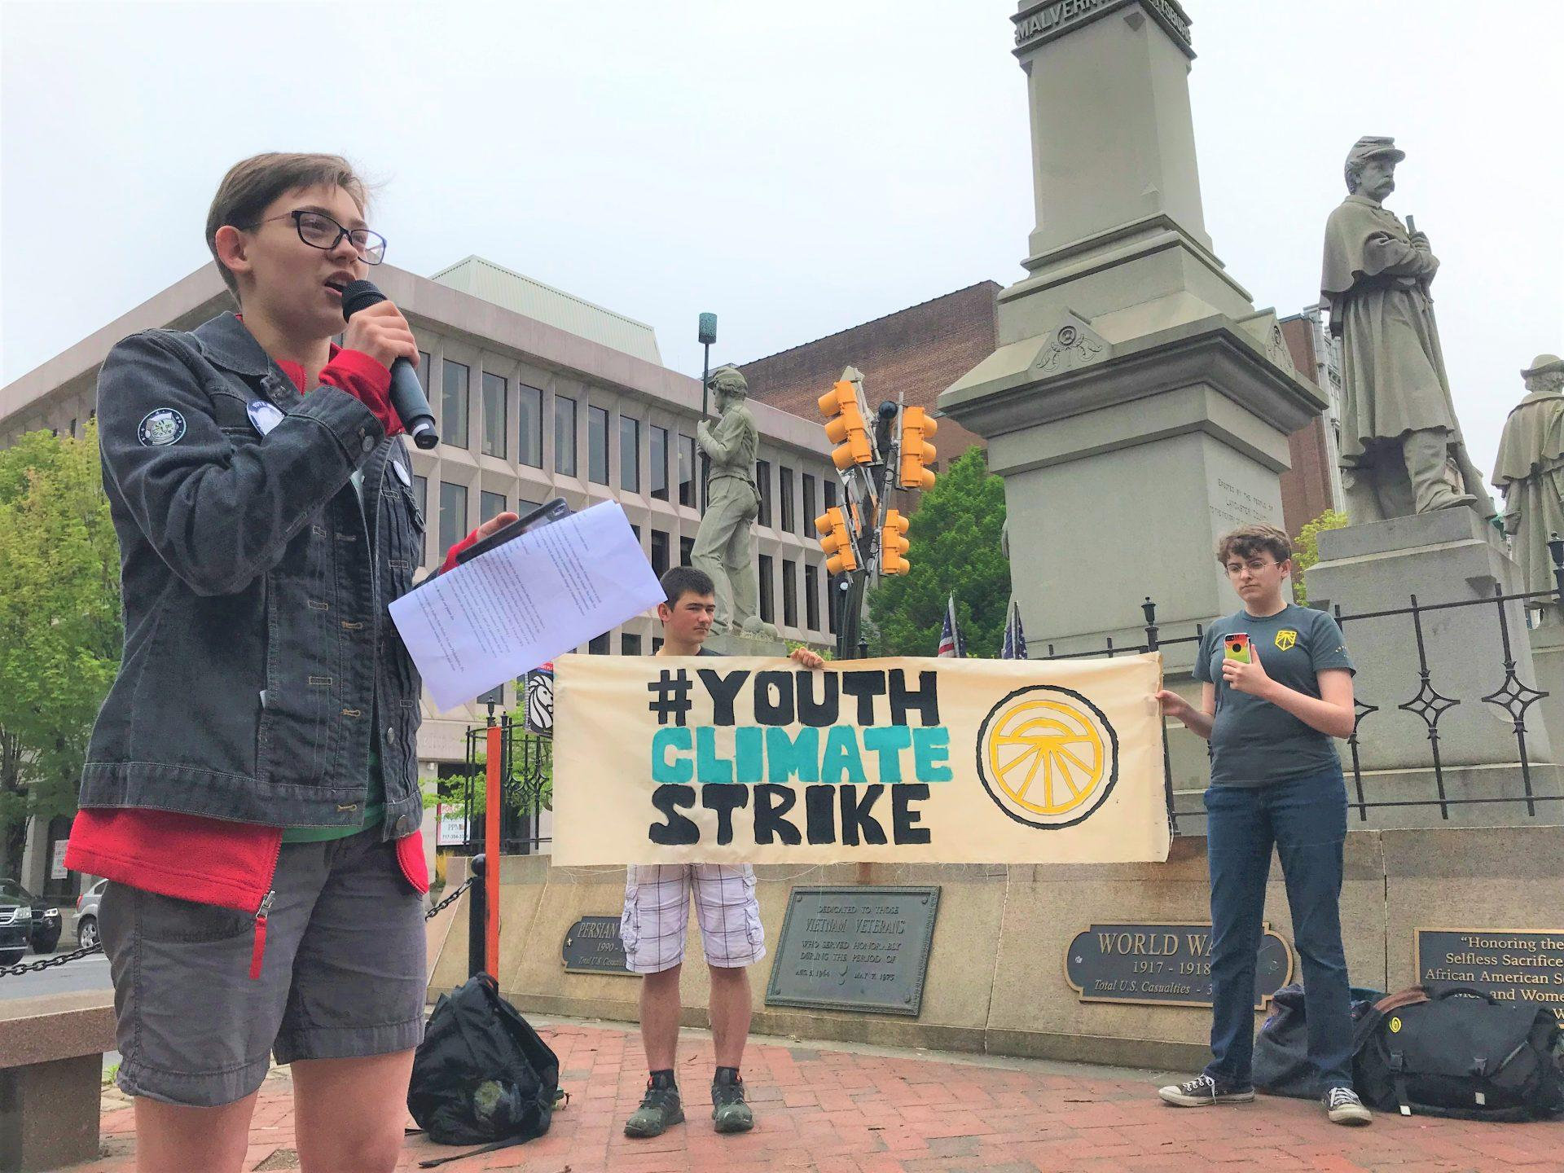
Protest
Notes:
https://www.wesa.fm/post/pa-youth-join-global-student-strike-demand-action-climate-change

Slide 34

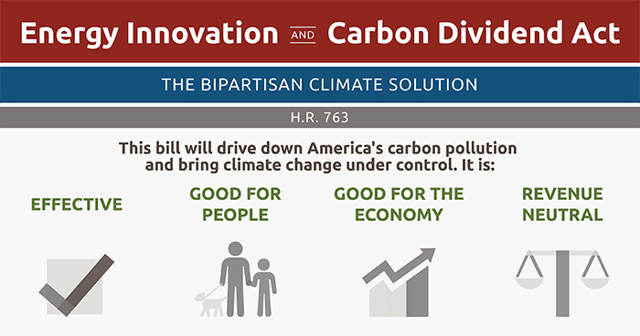
Join climate action groups and support emissions reductions policies
Notes:
https://citizensclimatelobby.org/energy-innovation-and-carbon-dividend-act/

Slide 35





Support the Paris Agreement
Agreement to keep global warming well below 2.0 ºC (3.6 ºF)
Source: COP21 Paris
Notes:
Image source: www.cop21paris.org/

Slide 36
We have cleaned up our own messes before

Slide 37
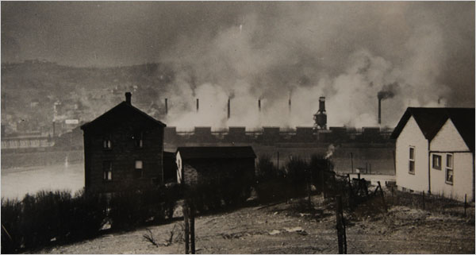
“Smog episodes”
October 1948: Pollution from zinc mills in Donora, PA combined with a temperature inversion, leads to 20 deaths
Source: Donora Smog Museum

Slide 38
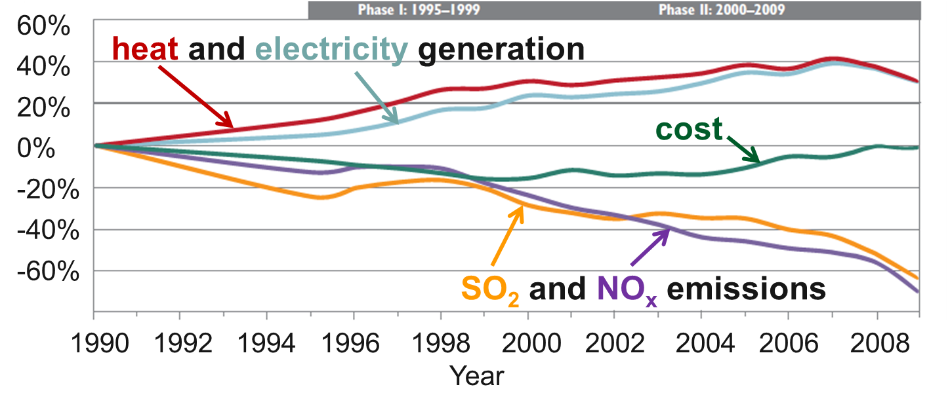
The Clean Air act reduced emissions and created $170 - $430 billion per year in health benefits—all while energy use went up and costs went down!
Burns et al. (2011)
Notes:
Burns, D.A., Baron, J.S., Cosby, B.J., Fenn, M.E., Lynch, J.A., 2011. National Acid Precipitation Assessment Program Report to Congress 2011: An Integrated Assessment. National Science and Technology Council, United States Government, Washington, D.C., 114 pp.

Slide 39
Take-home messages
Pennsylvania has followed the global warming trend
Impacts are already being felt
Human-induced climate change will continue to occur regardless of emissions scenario; further adaptation is necessary.
The climate of the mid century and beyond is very sensitive to the emissions scenario.
Solving the climate crisis is an opportunity to make the world better
Good science and good policy has gotten us out of environmental messes before

