Slide 1
Climate impacts on Pennsylvania
Raymond Najjar
Professor of Oceanography
Department of Meteorology and Atmospheric Science
The Pennsylvania State University
Citizens Climate Lobby Mid-Atlantic Conference Philadelphia, PA
February 18, 2017

Slide 2
PA Climate Assessments and Updates
2009 Pennsylvania Climate Impact Assessment
2013 Update
2015 Update
2015 advances in modeling techniques:
New greenhouse gas scenarios;
New global climate models
New downscaling techniques
18-person team led by Jim Shortle
Report at psiee.psu.edu/climate-impacts
Notes:
Shortle, J., Abler, D., Blumsack, S., McDill, M., Najjar, R., Ready, R., Ross, A., Rydzik, M., Wagener, T., Wardrop, D., 2013. Pennsylvania Climate Impacts Assessment Update, Report to the Pennsylvania Department of Environmental Protection. Environment and Natural Resources Institute, The Pennsylvania State University, University Park, Pennsylvania, 155 pp.

Slide 3
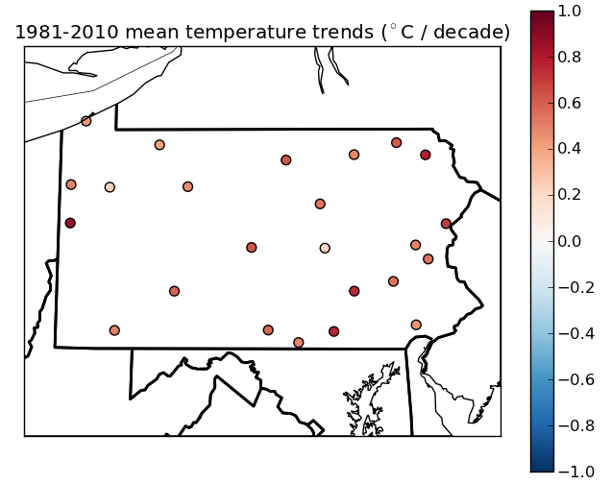
Pennsylvania is warming by 0.5 °F per decade
(°F/decade)
Shortle et al. (2013)
Notes:
Shortle, J., Abler, D., Blumsack, S., McDill, M., Najjar, R., Ready, R., Ross, A., Rydzik, M., Wagener, T., Wardrop, D., 2013. Pennsylvania Climate Impacts Assessment Update, Report to the Pennsylvania Department of Environmental Protection. Environment and Natural Resources Institute, The Pennsylvania State University, University Park, Pennsylvania, 155 pp.

Slide 4
Summers in Pennsylvania will feel like those of the Southeast US by mid-century if heat trapping emissions trends continue
http://psiee.psu.edu/climate-impacts

Slide 5
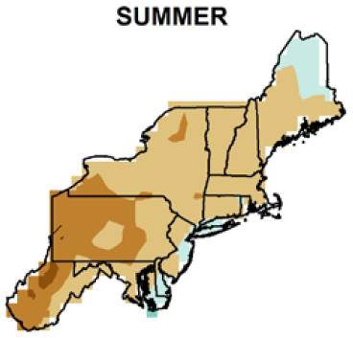
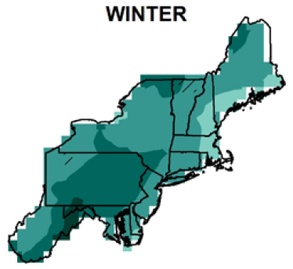
Expect summers to be drier …
… and winters to be wetter
0
8
12
-4
16
Percent precipitation change by 2050s
Kunkel et al. (2013)
Notes:
Kunkel, K.E., Stevens, L.E., Stevens, S.E., Sun, L., Janssen, E., Wuebbles, D., Rennells, J., DeGaetano, A., Dobson, J.G., 2013. Regional Climate Trends and Scenarios for the U.S. National Climate Assessment, Part 1. Climate of the Northeast U.S., NOAA Technical Report NESDIS 142-1. U.S. Department of Commerce, Washington, D.C., 79 pp.

Slide 6
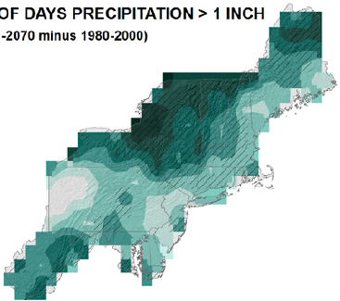
Expect heavy downpours to continue to increase
Percent change by 2050s in days > 1”
21
27
21
15
Kunkel et al. (2013)
Notes:
Kunkel, K.E., Stevens, L.E., Stevens, S.E., Sun, L., Janssen, E., Wuebbles, D., Rennells, J., DeGaetano, A., Dobson, J.G., 2013. Regional Climate Trends and Scenarios for the U.S. National Climate Assessment, Part 1. Climate of the Northeast U.S., NOAA Technical Report NESDIS 142-1. U.S. Department of Commerce, Washington, D.C., 79 pp.

Slide 7
Sectors
Energy
Agriculture
Forestry
Water quantity & quality
Human health
Tourism & outdoor recreation
Image: Penn State Institutes of Energy and the Environment

Slide 8
Energy impacts
Increased energy consumption due to more summer cooling (outweighs less winter heating)
Reduced availability of cooling water for electric power generation
Reduced grid reliability due to stronger storms and floods

Slide 9
Energy
How Can Pennsylvania Prepare?
Increase the application of energy-efficient technologies
Adopt policies to encourage shift of electricity demand to non-peak times
Encourage efficient building-integrated sources of backup power
Develop smart energy micro-grids to increase resilience of the energy system

Slide 10
Tourism & Outdoor Recreation impacts
Longer warm season for outdoor activities but extreme heat periods will increase
Some rivers and streams will no longer be suited for cold-water fishing
Higher snow-making costs may make ski resorts economically unviable

Slide 11
Tourism and Outdoor Recreation
How Can Pennsylvania Prepare?
Expect an increased demand for summer outdoor recreation opportunities
More educational programs to avoid insect-borne and water-borne diseases
People with respiratory diseases and allergies should take extra precaution

Slide 12
Water Quality and Quantity Impacts
Peak flows will continue to rise, likely causing higher bank erosion, lower stream health, impaired habitat, and higher sediment outputs
Flood risks to infrastructure will increase
Ability of wetlands to improve water quality, flood storage, and habitat will be diminished
Warming will counteract improvements in dissolved oxygen levels made under the Clean Water Act

Slide 13
Water Quality and Quantity
How Can Pennsylvania Prepare?
Strengthen flood management infrastructure
Improve non-point source pollution control to reduce nutrient and pathogen loading to rivers and streams.
Increase programs for monitoring, assessing, and abating water channel degradation.
Enhance wetland conservation to maintain/increase the adaptive capacity that these systems provide for stream water quality and quantity.

Slide 14
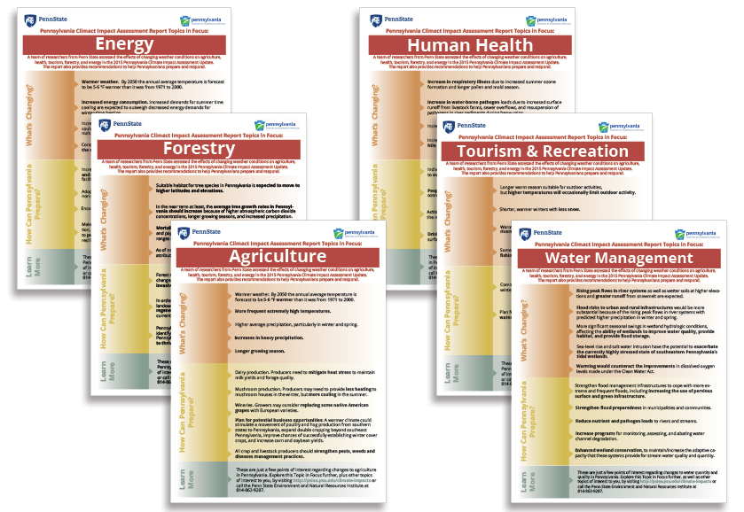
Factsheets for Public Education
http://psiee.psu.edu/climate-impacts

