Slide 1


Climate Change in the Mid-Atlantic Region
Raymond Najjar
Professor of Oceanography
Department of Meteorology and Atmospheric Science
The Pennsylvania State University
rgn1@psu.edu
Mid-Atlantic Partnership Conference
January 15, 2021

Slide 2
Outline
Global climate change
Climate change in the Mid-Atlantic Region
Future scenarios

Slide 3
Global climate change

Slide 4
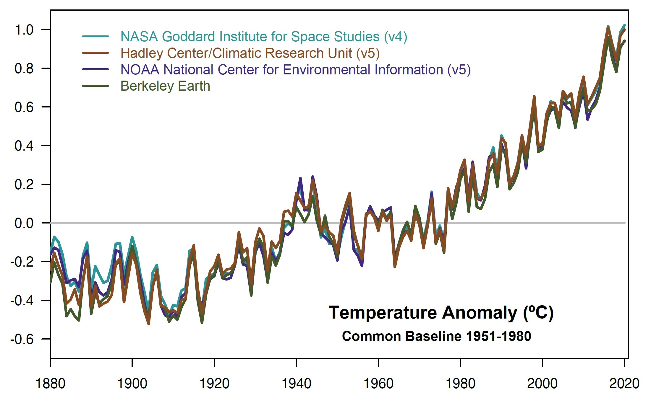
2020 was a statistical tie with 2016 as Earth’s warmest year on record
Temperature anomaly (ºC)
Credits: NASA GISS/Gavin Schmidt
Notes:
https://www.nasa.gov/press-release/2020-tied-for-warmest-year-on-record-nasa-analysis-shows

Slide 5
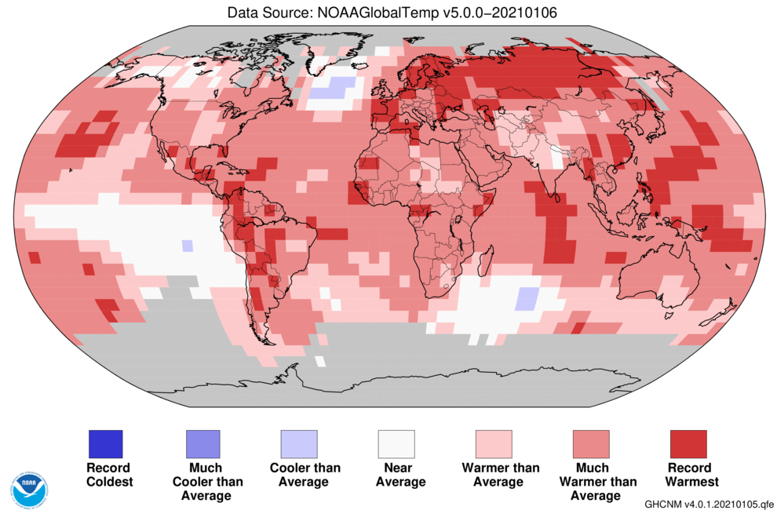
In 2020, most places were much warmer than average and many had record warming
Notes:
https://www.noaa.gov/news/2020-was-earth-s-2nd-hottest-year-just-behind-2016

Slide 6
Sea level is accelerating
8 inches
Year
Columbia University Earth Institute
Notes:
http://www.columbia.edu/~mhs119/SeaLevel/

Slide 7
We cannot explain observed warming with natural drivers …
1951–1980 average
Fourth National Climate Assessment, Hayhoe et al. (2018)
Notes:
Hayhoe, K., Wuebbles, D.J., Easterling, D.R., Fahey, D.W., Doherty, S., Kossin, J., Sweet, W., Vose, R., Wehner, M., 2018. Our changing climate. In: D.R. Reidmiller, C.W. Avery, D.R. Easterling, K.E. Kunkel, K.L.M. Lewis, T.K. Maycock, B.C. Stewart (Editors), Impacts, Risks, and Adaptation in the United States: Fourth National Climate Assessment. US Global Change Research Program, Washington, DC, USA, pp. 72–144.

Slide 8
… but we can with human drivers
1951–1980 average
Fourth National Climate Assessment, Hayhoe et al. (2018)
Notes:
Hayhoe, K., Wuebbles, D.J., Easterling, D.R., Fahey, D.W., Doherty, S., Kossin, J., Sweet, W., Vose, R., Wehner, M., 2018. Our changing climate. In: D.R. Reidmiller, C.W. Avery, D.R. Easterling, K.E. Kunkel, K.L.M. Lewis, T.K. Maycock, B.C. Stewart (Editors), Impacts, Risks, and Adaptation in the United States: Fourth National Climate Assessment. US Global Change Research Program, Washington, DC, USA, pp. 72–144.

Slide 9
Climate change in the Mid-Atlantic Region

Slide 10
The Mid-Atlantic Region has followed or exceeded the global warming trend
PA
50
1990–2020 trends (ºF per decade)
45
MD
Globe | 0.4
PA | 0.4
MD | 0.5
DE | 0.7
55
Temperature (ºF)
50
DE
55
50
Source: NOAA Climate at a Glance
1900 1940 1980 2020

Slide 11
The ratio of snow to total precipitation is mostly decreasing in the Northeast US
1949–2005 trend
Decreasing
Increasing
Feng and Hu (2007)
Notes:
Feng, S., Hu, Q., 2007. Changes in winter snowfall/precipitation ratio in the contiguous United States. Journal of Geophysical Research: Atmospheres 112, doi: 10.1029/2007jd008397.

Slide 12
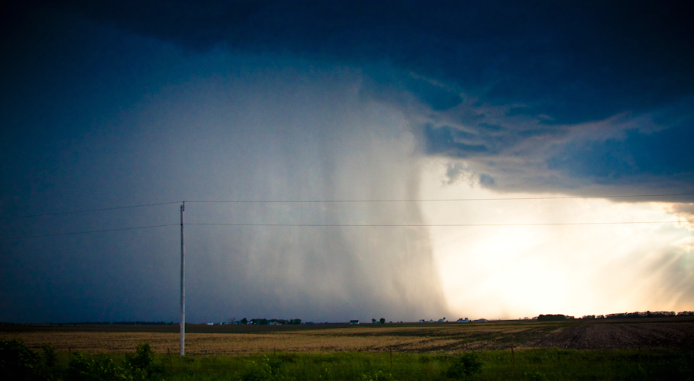
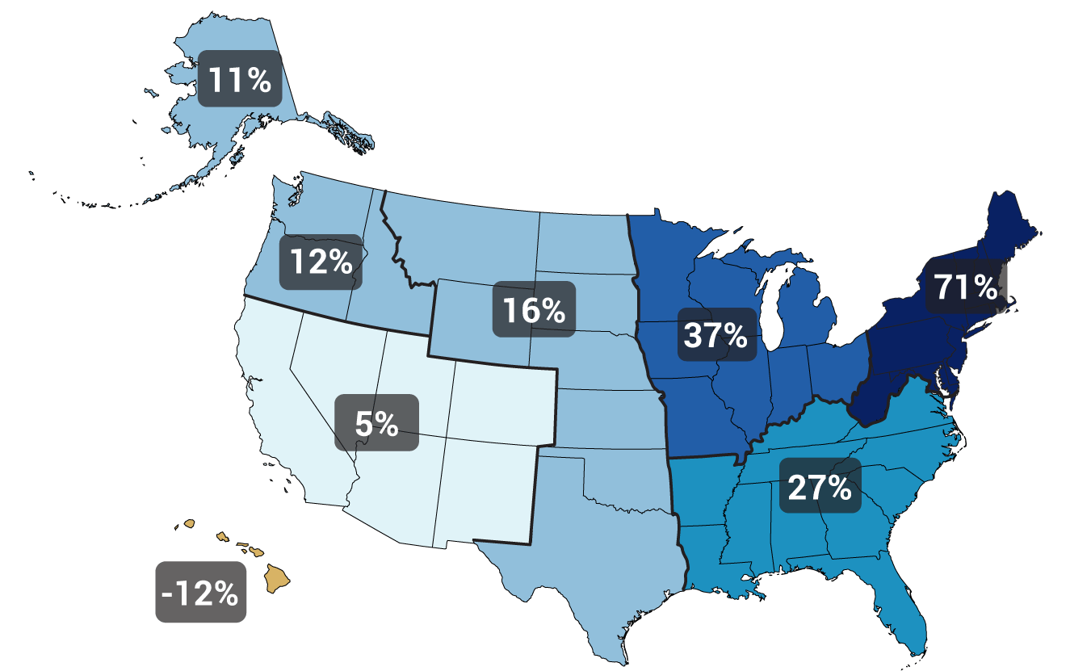
Heavy precipitation is increasing
Gustoflight.wordpress.com
Change in top 1% of rainiest days from 1958 to 2012
Walsh et al. (2014)
Notes:
Walsh, J., Wuebbles, D., Hayhoe, K., Kossin, J., Kunkel, K., Stephens, G., Thorne, P., Vose, R., Wehner, M., Willis, J., Anderson, D., Doney, S., Feely, R., Hennon, P., Kharin, V., Knutson, T., Landerer, F., Lenton, T., Kennedy, J., Somerville, R., 2014. Chapter 2: Our Changing Climate. In: J.M. Melillo, T.C. Richmond, G.W. Yohe (Editors), Climate Change Impacts in the United States: The Third National Climate Assessment. U.S. Global Change Research Program, pp. 19-67.

Slide 13
Coastal flooding has dramatically increased in the Mid-Atlantic Region as a result of sea-level rise
Source: EPA
Notes:
https://www.epa.gov/climate-indicators/climate-change-indicators-coastal-flooding

Slide 14
Photo by Wanda Diane Cole
Notes:
https://www.climate.gov/news-features/understanding-climate/understanding-climate-billy-sweet-and-john-marra-explain

Slide 15
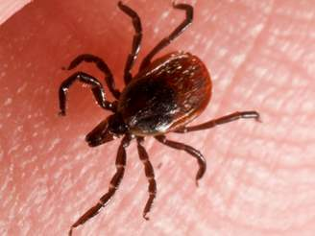
In Millbrook, NY, warming has led to an earlier larval peak of the blacklegged (deer) tick, the major Lyme disease transmitter
Earlier larval peak
Cumulative degree days through August
Warmer years
Levi et al. (2015)
Notes:
Levi, T., Keesing, F., Oggenfuss, K., Ostfeld, R.S., 2015. Accelerated phenology of blacklegged ticks under climate warming. Philosophical Transactions of the Royal Society B: Biological Sciences 370, 20130556.

Slide 16
Future climate scenarios

Slide 17
Three possible emissions futures …
Fourth National Climate Assessment, Wuebbles et al. (2017)
Notes:
Wuebbles, D.J., Easterling, D.R., Hayhoe, K., Knutson, T., Kopp, R.E., Kossin, J.P., Kunkel, K.E., LeGrande, A.N., Mears, C., Sweet, W.V., Taylor, P.C., Vose, R.S., Wehner, M.F., 2017. Our globally changing climate. In: D.J. Wuebbles, D.W. Fahey, K.A. Hibbard, D.J. Dokken, B.C. Stewart, T.K. Maycock (Editors), Climate Science Special Report: Fourth National Climate Assessment, Volume I. U.S. Global Change Research Program, Washington, DC, USA, pp. 35–72.

Slide 18
… lead to very different climate futures
Fourth National Climate Assessment, Wuebbles et al. (2017)
Notes:
Wuebbles, D.J., Easterling, D.R., Hayhoe, K., Knutson, T., Kopp, R.E., Kossin, J.P., Kunkel, K.E., LeGrande, A.N., Mears, C., Sweet, W.V., Taylor, P.C., Vose, R.S., Wehner, M.F., 2017. Our globally changing climate. In: D.J. Wuebbles, D.W. Fahey, K.A. Hibbard, D.J. Dokken, B.C. Stewart, T.K. Maycock (Editors), Climate Science Special Report: Fourth National Climate Assessment, Volume I. U.S. Global Change Research Program, Washington, DC, USA, pp. 35–72.

Slide 19
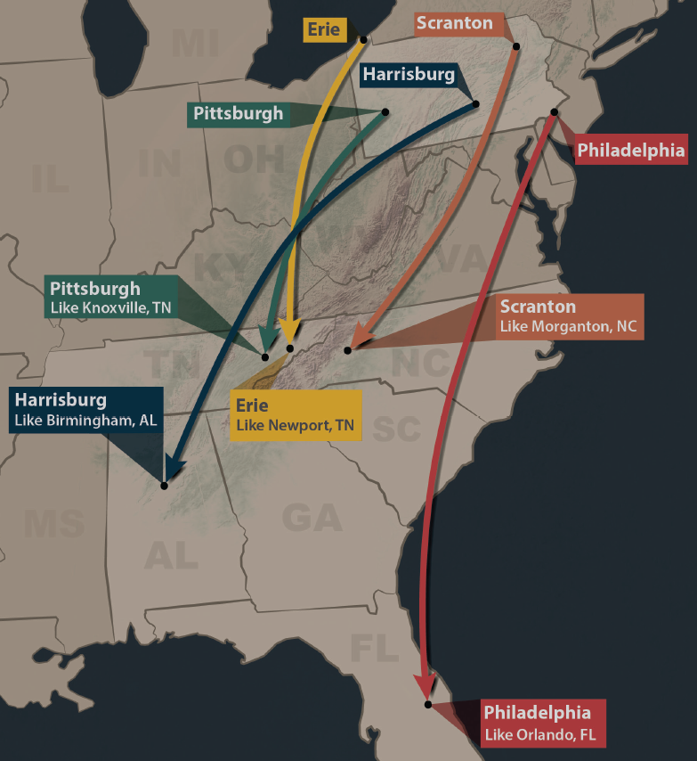
Summers in Pennsylvania will feel like those of the Southeast US by mid-century if heat trapping emissions trends continue
http://psiee.psu.edu/climate-impacts
Notes:
http://psiee.psu.edu/climate-impacts

Slide 20
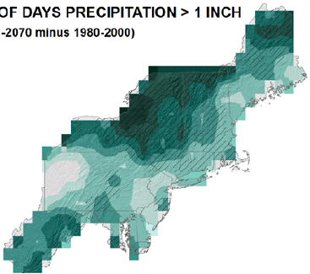

Expect heavy downpours to continue to increase
Percent change by 2050s in days > 1”
21
27
21
15
Kunkel et al. (2013)
Notes:
Kunkel, K.E., Stevens, L.E., Stevens, S.E., Sun, L., Janssen, E., Wuebbles, D., Rennells, J., DeGaetano, A., Dobson, J.G., 2013. Regional Climate Trends and Scenarios for the U.S. National Climate Assessment, Part 1. Climate of the Northeast U.S., NOAA Technical Report NESDIS 142-1. U.S. Department of Commerce, Washington, D.C., 79 pp.

Slide 21
Take-home messages
The world has warmed because of human activity (greenhouse gas emissions)
The Mid-Atlantic region has followed or exceeded the global warming trend
Human-induced climate change will continue to occur regardless of emissions scenario; further adaptation is necessary
The climate of the mid century and beyond is very sensitive to the emissions scenario; emissions reductions are imperative

