Slide 1
The oceans
and climate change
Raymond Najjar
Professor of Oceanography
Department of Meteorology and Atmospheric Science
The Pennsylvania State University
rgn1@psu.edu
Presentation for Foxdale Village, State College, PA
January 13, 2021

Slide 2
Outline
The ocean’s role in the climate system
Impacts of anthropogenic CO₂ emissions on the ocean
Future climate scenarios
Solutions
Past environmental successes
What you can do

Slide 3
The ocean’s role in the climate system

Slide 4
heat H₂O
Ocean
Atmosphere
CO₂ etc.

Slide 5
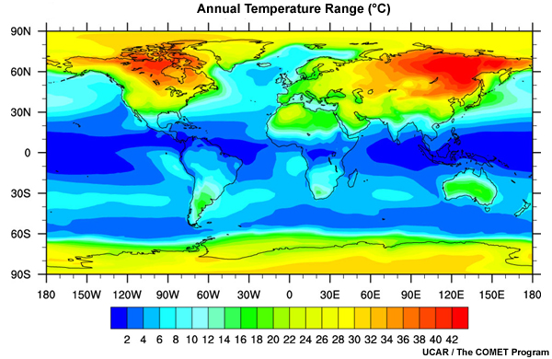
The seasonal temperature range (temperature of warmest month minus temperature of coldest month) is much smaller over the ocean than over land
Mean annual surface air temperature range (ºC)
Data from the Japanese Reanalysis Project (1979–2004)

Slide 6
Heat enters the ocean from the atmosphere in the tropics and leaves the ocean at higher latitudes
Schmitt (2018)
(red = into ocean, blue = out of ocean)
Notes:
Schmitt, R.W. 2018. The ocean’s role in climate. Oceanography 31(2):32–40, https://doi.org/10.5670/oceanog.2018.225 .

Slide 7
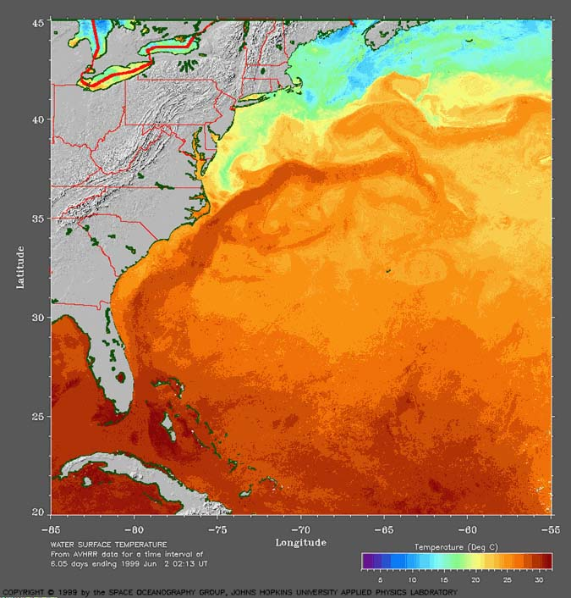
The Gulf Stream has a large impact on surface temperature
Gulf Stream
NASA

Slide 8
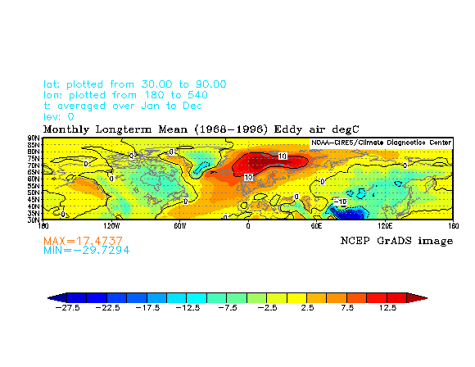
The Gulf Stream keeps Northern Europe relatively warm
Departure of air temperature from its longitudinal (east–west) average (ºC)
1968–1996 average. From the NCEP reanalysis atlas.

Slide 9
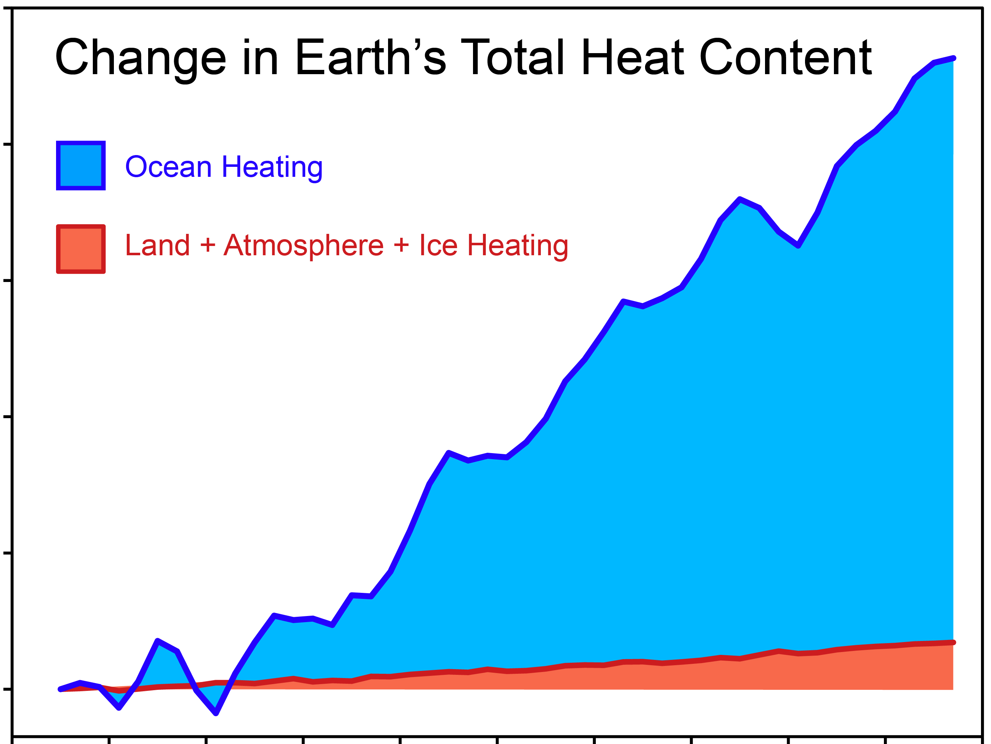
Most of the heat from global warming is going into the ocean
200
Change in total heat content since 1961 (10²¹ Joules)
100
0
1960 1970 1980 1990 2000 2010
skepticalscience.com after Church et al. (2011)
Notes:
Church, J.A., White, N.J., Konikow, L.F., Domingues, C.M., Cogley, J.G., Rignot, E., Gregory, J.M., van den Broeke, M.R., Monaghan, A.J., Velicogna, I., 2011. Revisiting the Earth's sea-level and energy budgets from 1961 to 2008. Geophysical Research Letters 38, L18601.

Slide 10
The ocean is the largest reservoir of carbon on Earth that readily exchanges with the atmosphere
Schmitt (2018)
Notes:
Schmitt, R.W. 2018. The ocean’s role in climate. Oceanography 31(2):32–40, https://doi.org/10.5670/oceanog.2018.225 .

Slide 11
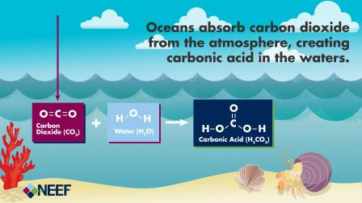
CO₂ and Water
CO₂ + H₂O ←→ H₂CO₃
H₂CO₃ ←→ H⁺ + CO₃^{2–} ←→ 2H⁺ + HCO₃–

Slide 12
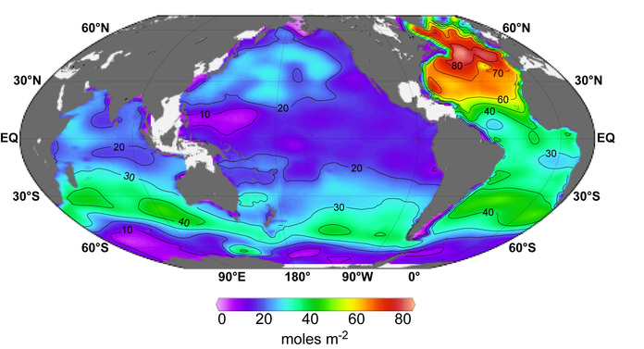
Storage of anthropogenic CO₂ in the ocean
Sabine et al. (2004)
Notes:
Sabine, C.L., Feely, R.A., Gruber, N., Key, R.M., Lee, K., Bullister, J.L., Wanninkhof, R., Wong, C., Wallace, D.W., Tilbrook, B., 2004. The oceanic sink for anthropogenic CO₂. Science 305, 367-371.

Slide 13
Global carbon budget (2009–2018)

Slide 14
Impacts of anthropogenic CO₂ emissions on the ocean

Slide 15
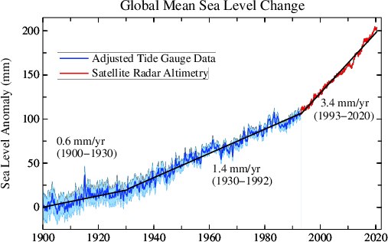
Sea level is accelerating
http://www.columbia.edu/~mhs119/SeaLevel/

Slide 16
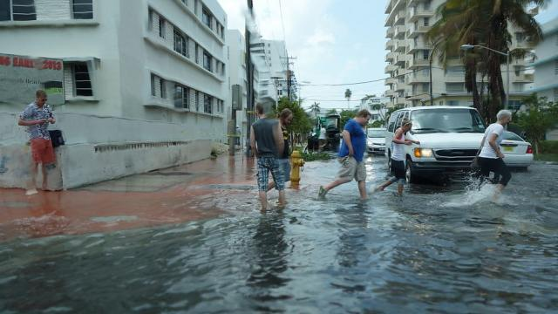
“Sunny day” flooding in Miami
Photo source: Grist

Slide 17
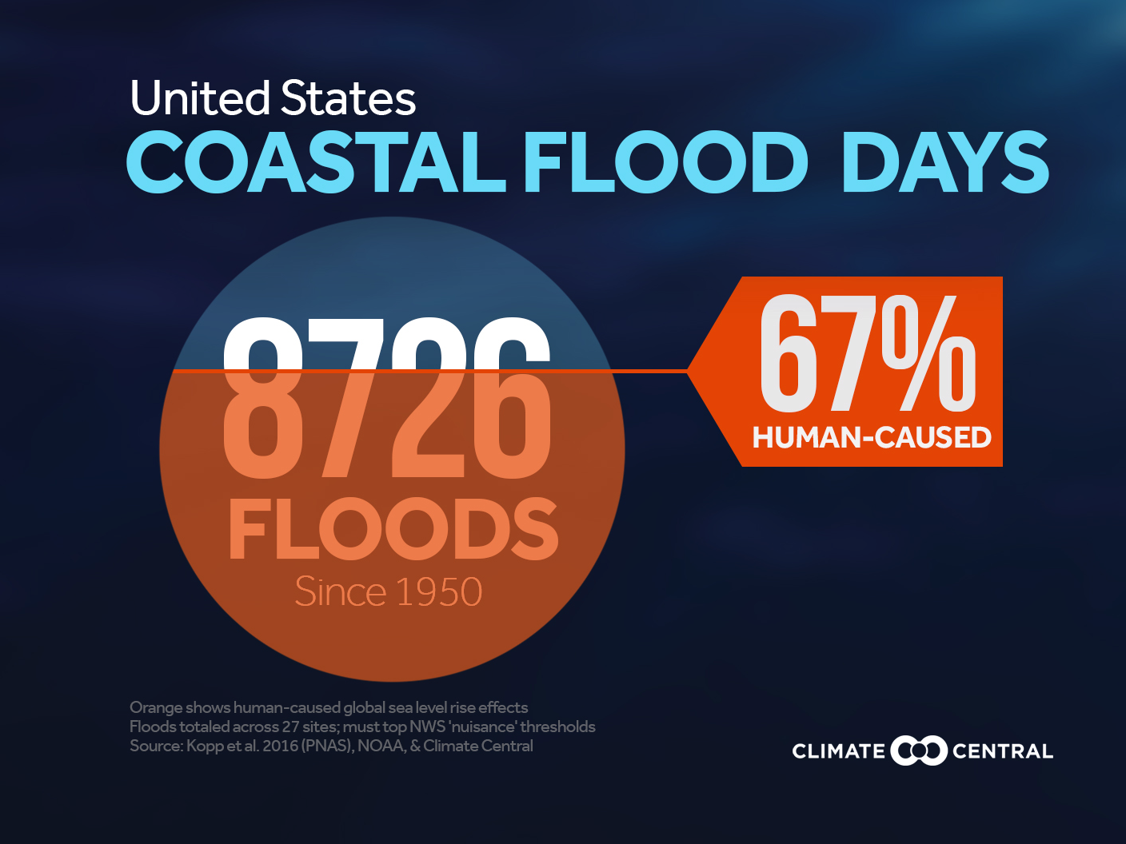

Slide 18
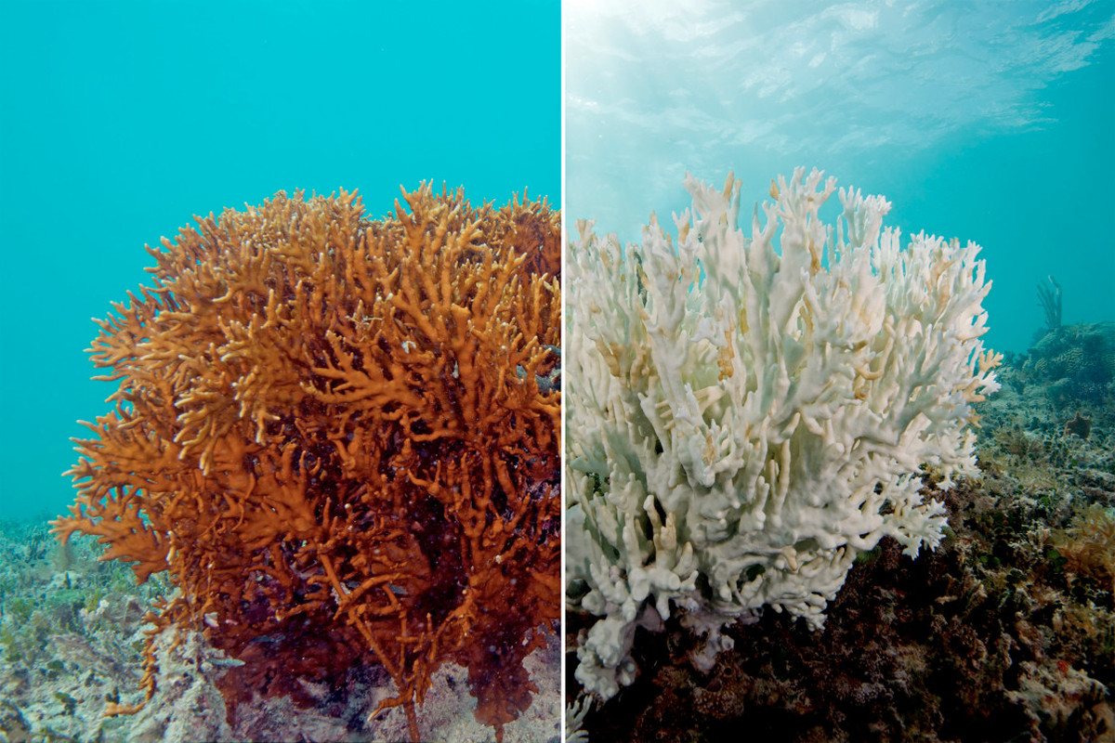
Corals bleach—lose their symbiotic algae—when they are stressed
Fire coral before 2016 warming event
After
Notes:
Photo of a fire coral that experienced severe bleaching in the 2016 mass bleaching event. The Ocean Agency / XL Catlin Seaview Survey / Richard Vevers. https://www.vox.com/science-and-health/2017/4/18/15272634/catastrophic-coral-bleaching-great-barrier-reef-map

Slide 19
Warming causes bleaching
Percent of reef bleached
Each data point represents an individual reef on the Great Barrier Reef in May/April 2016
Hughes et al. (2017)
Degree heating weeks (ºC – weeks)
Notes:
Hughes, T.P., Kerry, J.T., Álvarez-Noriega, M., Álvarez-Romero, J.G., Anderson, K.D., Baird, A.H., Babcock, R.C., Beger, M., Bellwood, D.R., Berkelmans, R., Bridge, T.C., Butler, I.R., Byrne, M., Cantin, N.E., Comeau, S., Connolly, S.R., Cumming, G.S., Dalton, S.J., Diaz-Pulido, G., Eakin, C.M., Figueira, W.F., Gilmour, J.P., Harrison, H.B., Heron, S.F., Hoey, A.S., Hobbs, J.-P.A., Hoogenboom, M.O., Kennedy, E.V., Kuo, C.-y., Lough, J.M., Lowe, R.J., Liu, G., McCulloch, M.T., Malcolm, H.A., McWilliam, M.J., Pandolfi, J.M., Pears, R.J., Pratchett, M.S., Schoepf, V., Simpson, T., Skirving, W.J., Sommer, B., Torda, G., Wachenfeld, D.R., Willis, B.L., Wilson, S.K., 2017. Global warming and recurrent mass bleaching of corals. Nature 543, 373–377.
Degree heating weeks are a bit complicated. First you compute the mean annual cycle in SST at monthly resolution. Second, of these 12 months, you find the month with the highest mean SST and you call it the maximum monthly mean (MMM) SST. The bleaching threshold is 1 deg C above the MMM. Third, you look at the past 12 weeks and find all of the half-week periods in which the 50-km SST is above the threshold. Call the exceedance DT. For each half week period, you multiply DT by 0.5 weeks. Then you add up all of these products to get DHW. Source: https://coralreefwatch.noaa.gov/satellite/education/tutorial/crw24_dhw_product.php

Slide 20
Massive coral bleaching occurred during 2014–2017
DHW = Degree Heating Weeks (ºC - weeks)
0 < DHW < 4
Coral bleaching likely
(4 < DHW < 8)
Coral mortality likely
(8 < DHW )
Eakin et al. (2018)
Notes:
Eakin, C.M., Liu, G., Gomez, A.M., De La Cour, J.L., Heron, S.F., Skirving, W.J., Geiger, E.F., Marsh, B.L., Tirak, K.V., Strong, A.E., 2018. Sidebar 3.1: Unprecedented Three Years of Global Coral Bleaching 2014–17. Bulletin of the American Meteorological Society 9, S74–75.

Slide 21
Record high ocean temperatures intensified Harvey and increased its flooding rains on land
“Harvey could not have produced so much rain without human-induced climate change”
Trenberth et al. (2018)
Notes:
Trenberth, K.E., Cheng, L., Jacobs, P., Zhang, Y., Fasullo, J., 2018. Hurricane Harvey Links to Ocean Heat Content and Climate Change Adaptation. Earth's Future 6, 730-744.

Slide 22
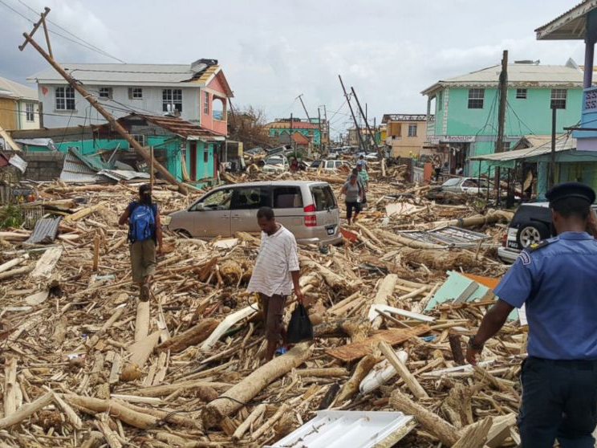
Maria's rain magnitude nearly five times more likely to occur today than in the 1950s
Keelings et al. (2019)
Notes:
Image: https://abcnews.go.com/International/hurricane-maria-strengthens-category-ravaging-puerto-rico/story?id=49997188
Keellings, D., & Hernández Ayala, J. J. (2019). Extreme rainfall associated with Hurricane Maria over Puerto Rico and its connections to climate variability and change. Geophysical Research Letters,46, 2964–2973. https://doi.org/10.1029/2019GL082077

Slide 23
CO₂ and Water
CO₂ + H₂O ←→ H₂CO₃
H₂CO₃ ←→ H⁺ +CO₃^{2–} ←→ 2H⁺ + HCO₃–
Formation of H⁺ is ocean acidification

Slide 24
pH in the Northern Hemisphere subtropical ocean (note: pH = –log[H⁺])
Bermuda Hawaii Canary Islands
pH
Year
Cooley et al. (2018)
Notes:
Cooley, S.R., Moore, D.J.P., Alin, S.R., Butman, D., Clow, D.W., French, N.H.F., Feely, R.A., Johnson, Z.I., Keppel-Aleks, G., Lohrenz, S.E., Ocko, I.B., Shadwick, E.H., Sutton, A.J., Potter, C.S., Takatsuka, Y., Walker, A.P., Yu, R.M.S., 2018. Chapter 17: Biogeochemical effects of rising atmospheric carbon dioxide. In: N. Cavallaro, G. Shrestha, R. Birdsey, M. A. Mayes, R. G. Najjar, S. C. Reed, P. Romero-Lankao, and Z. Zhu (Editor), Second State of the Carbon Cycle Report (SOCCR2): A Sustained Assessment Report. U.S. Global Change Research Program, Washington, DC, USA, pp. 690–727.

Slide 25
Future climate scenarios

Slide 26
Three possible emissions futures …
Fourth National Climate Assessment, Wuebbles et al. (2017)
Notes:
Wuebbles, D.J., Easterling, D.R., Hayhoe, K., Knutson, T., Kopp, R.E., Kossin, J.P., Kunkel, K.E., LeGrande, A.N., Mears, C., Sweet, W.V., Taylor, P.C., Vose, R.S., Wehner, M.F., 2017. Our globally changing climate. In: D.J. Wuebbles, D.W. Fahey, K.A. Hibbard, D.J. Dokken, B.C. Stewart, T.K. Maycock (Editors), Climate Science Special Report: Fourth National Climate Assessment, Volume I. U.S. Global Change Research Program, Washington, DC, USA, pp. 35–72.

Slide 27
… lead to very different climate futures
Fourth National Climate Assessment, Wuebbles et al. (2017)
Notes:
Wuebbles, D.J., Easterling, D.R., Hayhoe, K., Knutson, T., Kopp, R.E., Kossin, J.P., Kunkel, K.E., LeGrande, A.N., Mears, C., Sweet, W.V., Taylor, P.C., Vose, R.S., Wehner, M.F., 2017. Our globally changing climate. In: D.J. Wuebbles, D.W. Fahey, K.A. Hibbard, D.J. Dokken, B.C. Stewart, T.K. Maycock (Editors), Climate Science Special Report: Fourth National Climate Assessment, Volume I. U.S. Global Change Research Program, Washington, DC, USA, pp. 35–72.

Slide 28
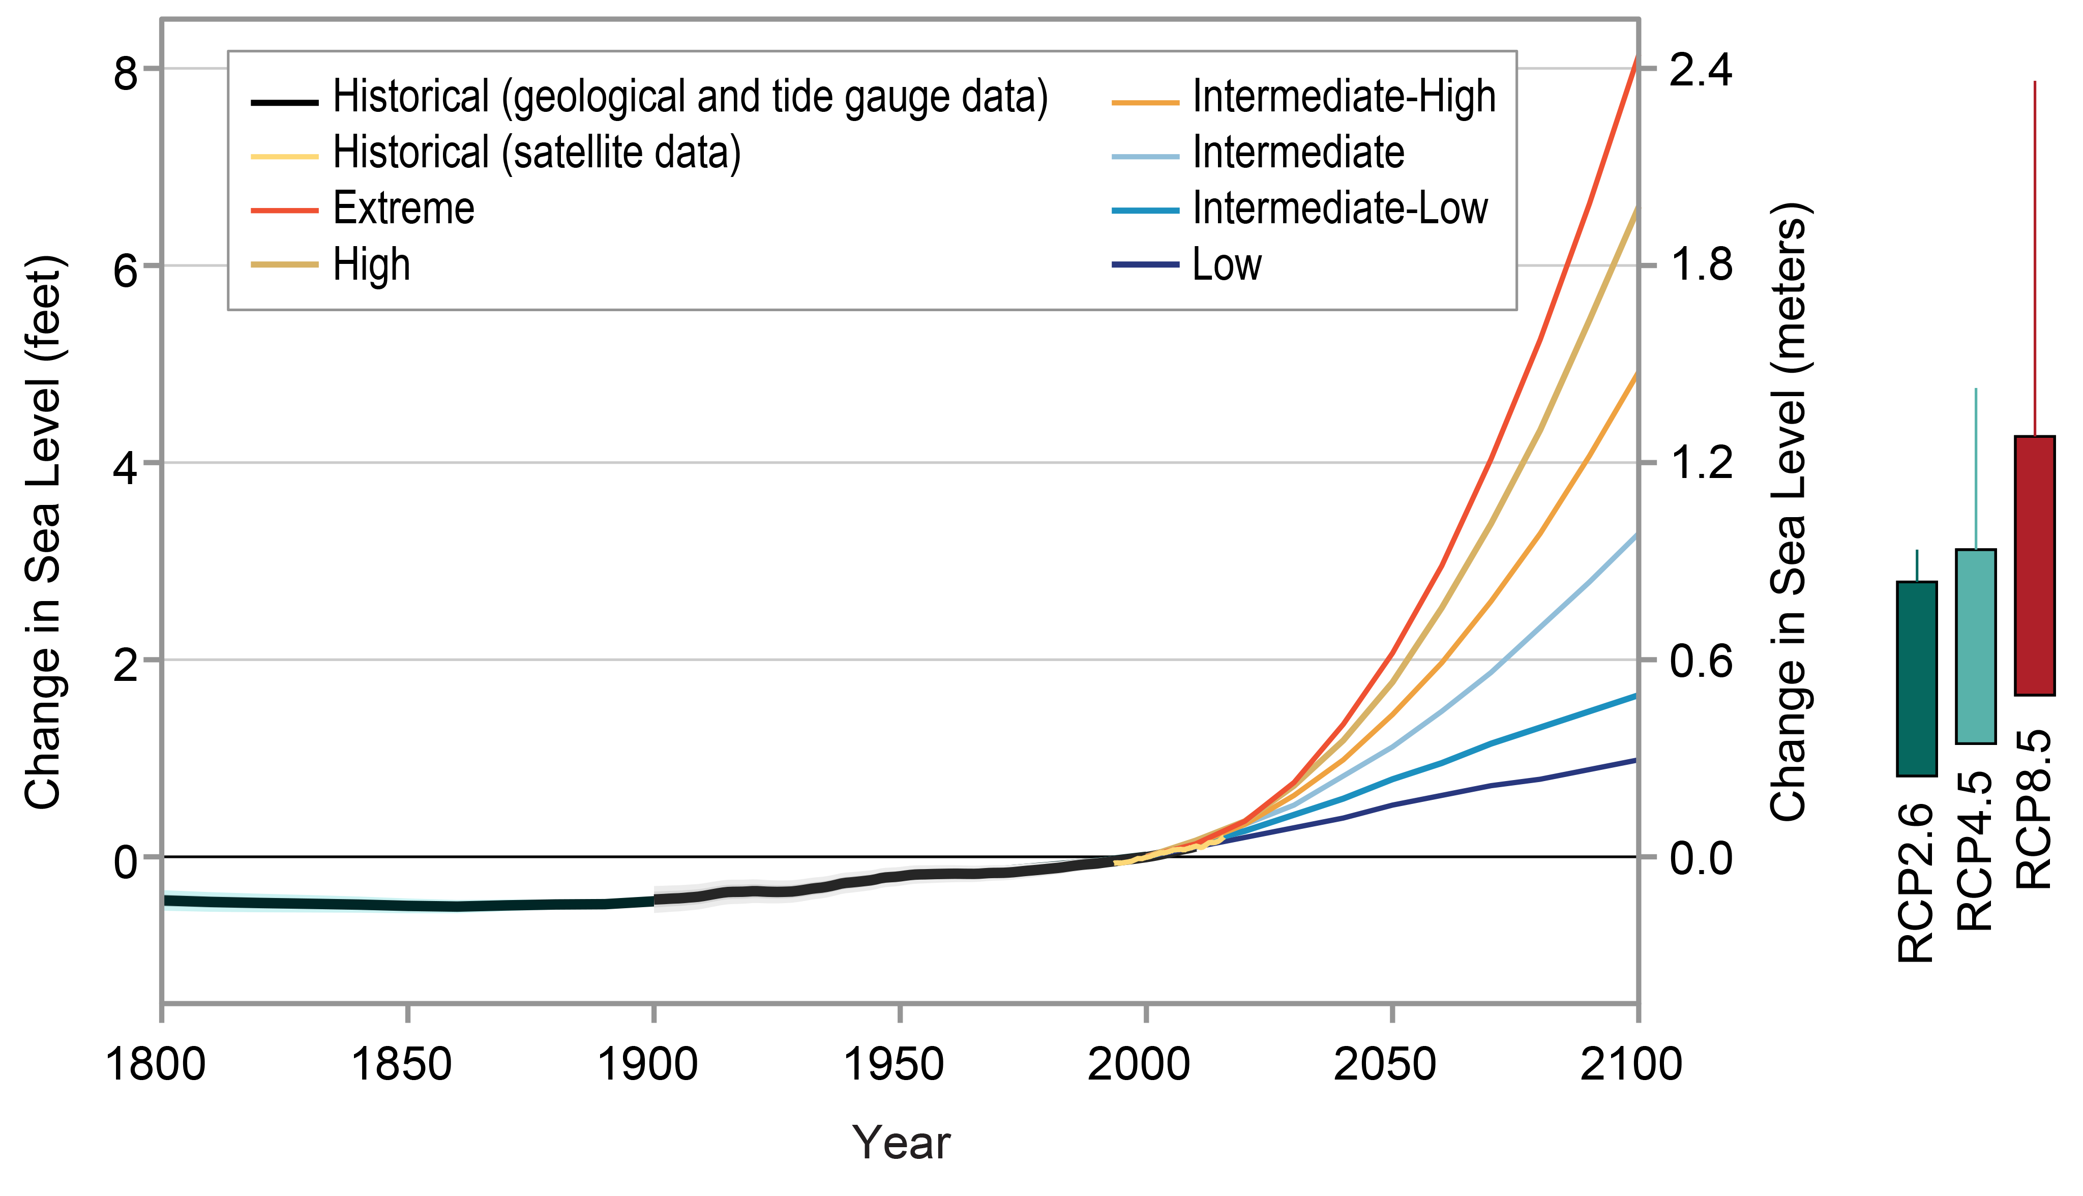
Simulated changes in global-mean sea level

Slide 29
Simulated changes in surface ocean pH
Averages and ranges from 11 Earth system models
Cooley et al. (2018)
Notes:
Cooley, S.R., Moore, D.J.P., Alin, S.R., Butman, D., Clow, D.W., French, N.H.F., Feely, R.A., Johnson, Z.I., Keppel-Aleks, G., Lohrenz, S.E., Ocko, I.B., Shadwick, E.H., Sutton, A.J., Potter, C.S., Takatsuka, Y., Walker, A.P., Yu, R.M.S., 2018. Chapter 17: Biogeochemical effects of rising atmospheric carbon dioxide. In: N. Cavallaro, G. Shrestha, R. Birdsey, M. A. Mayes, R. G. Najjar, S. C. Reed, P. Romero-Lankao, and Z. Zhu (Editor), Second State of the Carbon Cycle Report (SOCCR2): A Sustained Assessment Report. U.S. Global Change Research Program, Washington, DC, USA, pp. 690–727.

Slide 30
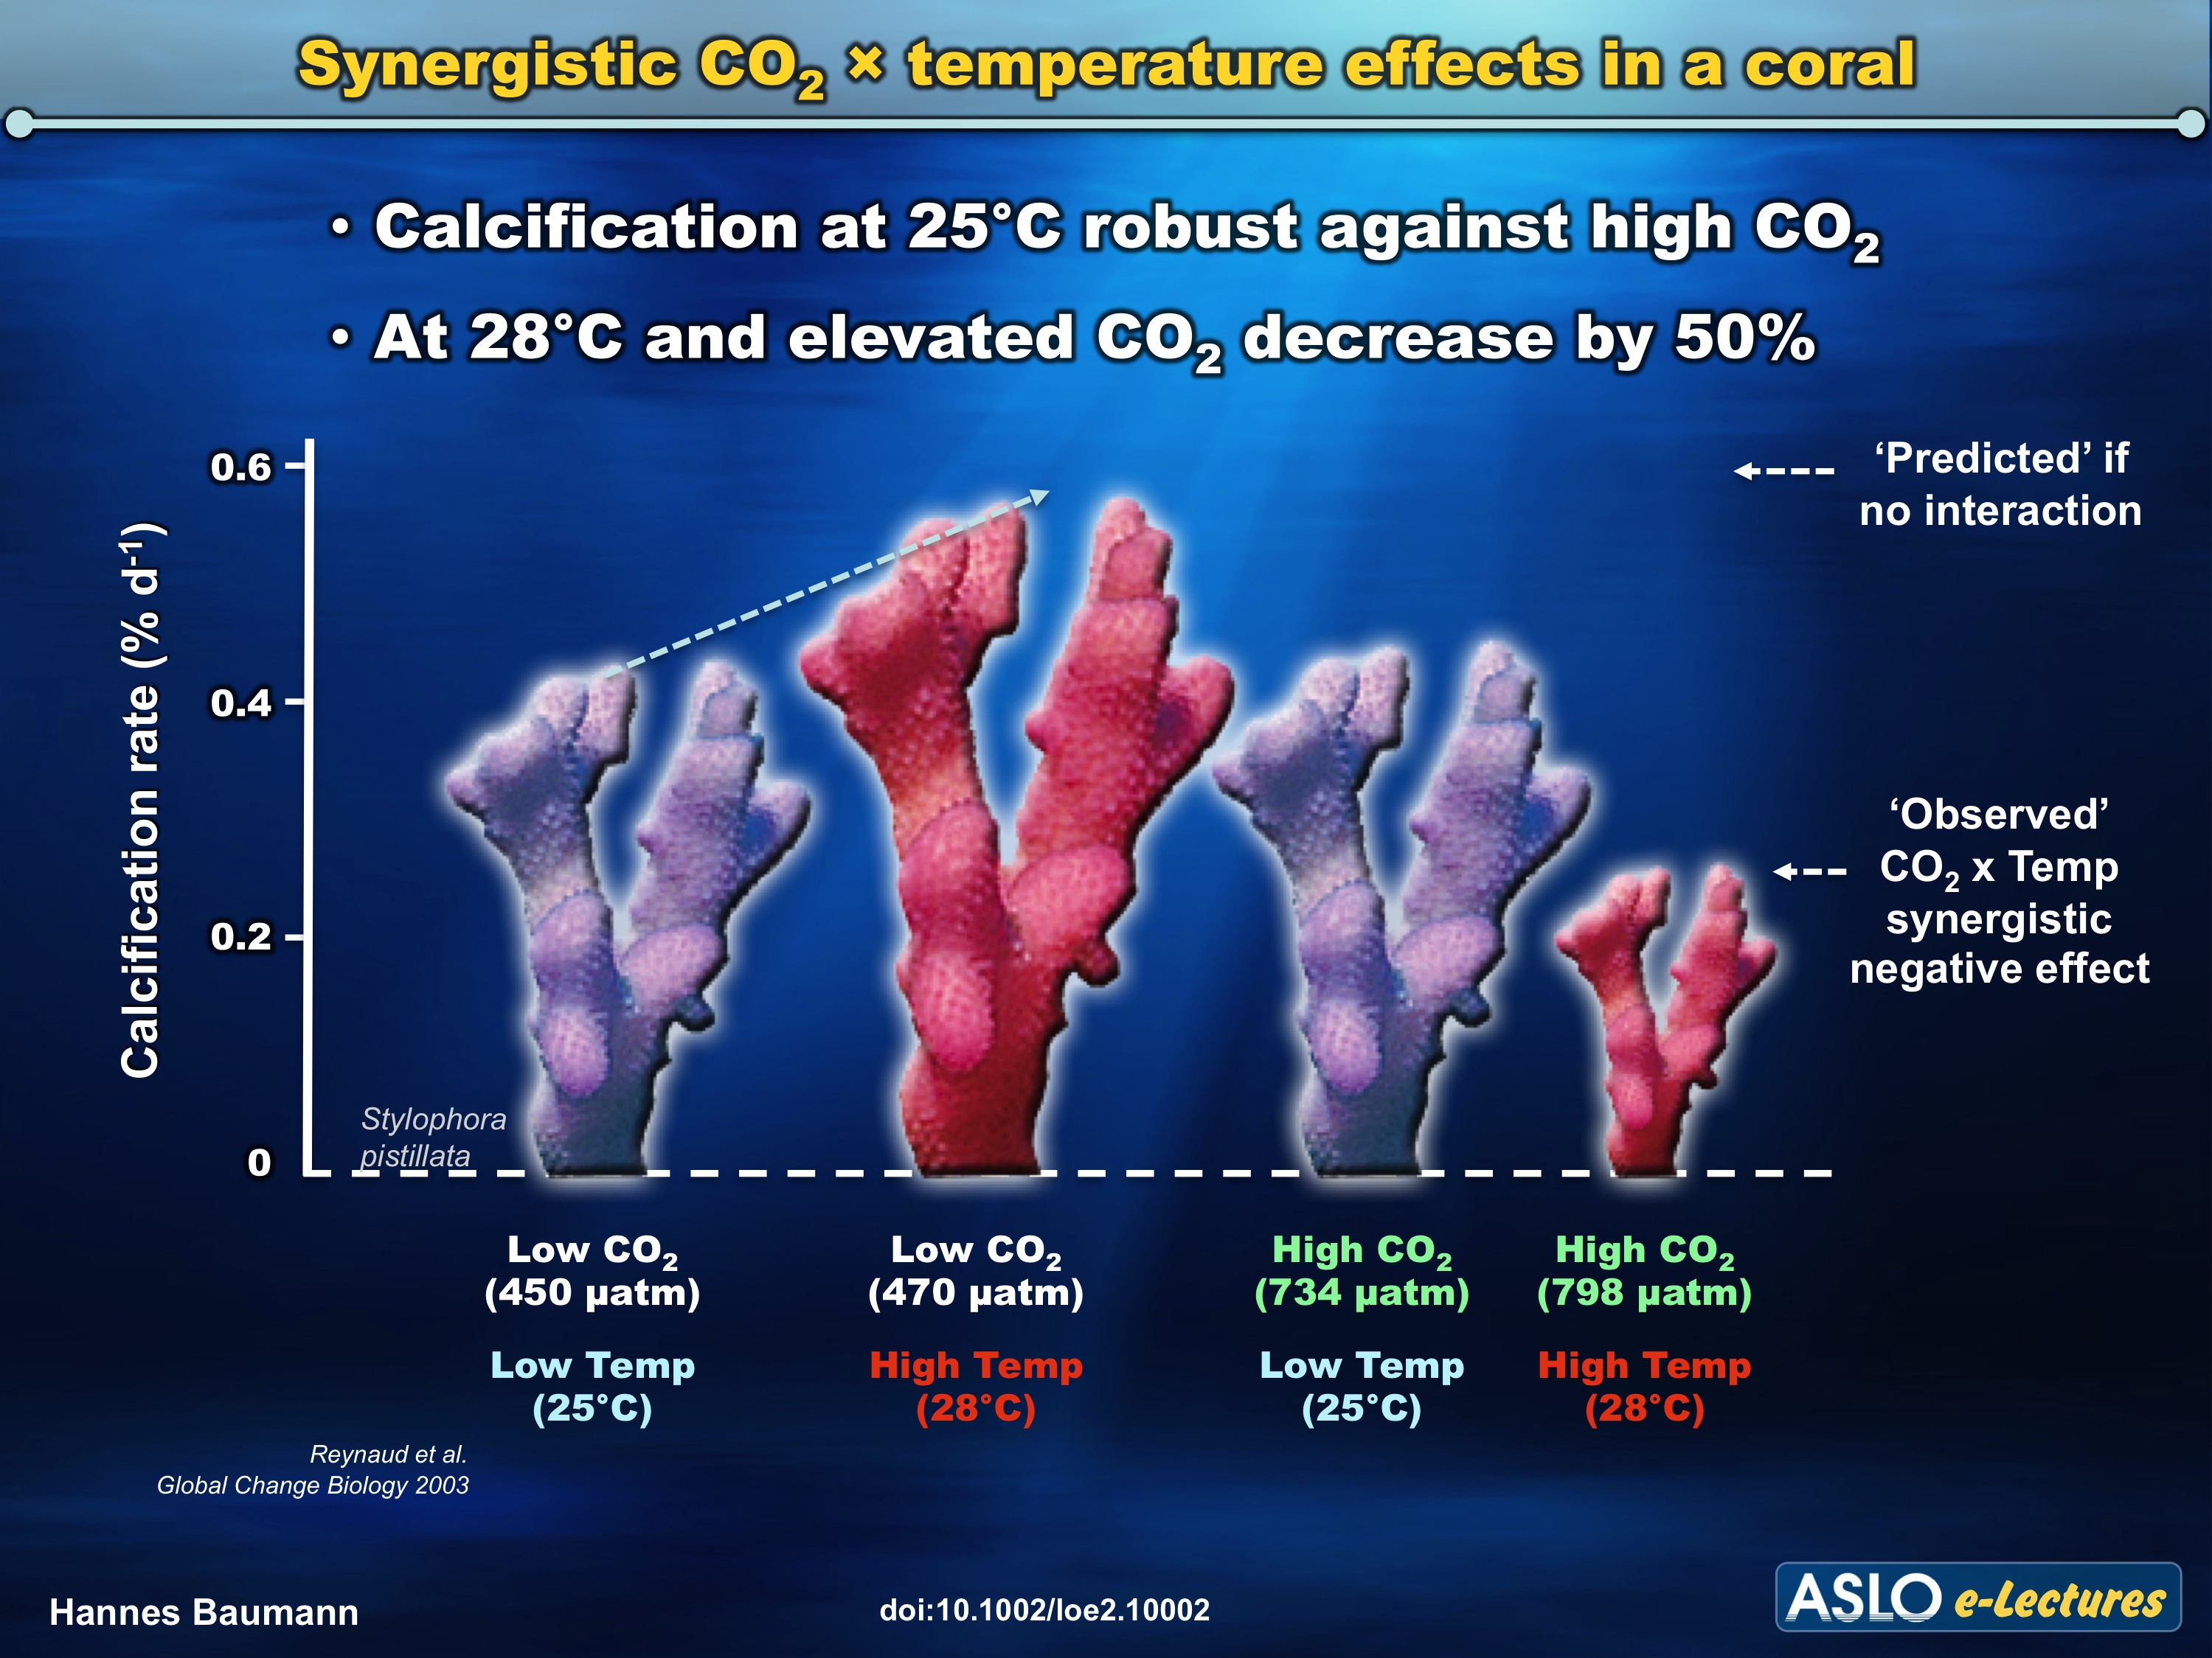
Notes:
Reynaud S, Leclercq N, Romaine-Lioud S, Ferrier-Pagés C, Jaubert J, Gattuso J-P (2003). Interacting effects of CO₂ partial pressure and temperature on photosynthesis and calcification in a scleractinian coral. Glob Change Biol 9:1660-1668
Baumann, H., 2016. Combined Effects of Ocean Acidification, Warming, and Hypoxia on Marine Organisms. Limnology and Oceanography e-Lectures 6, 1-43.

Slide 31
Solutions

Slide 32
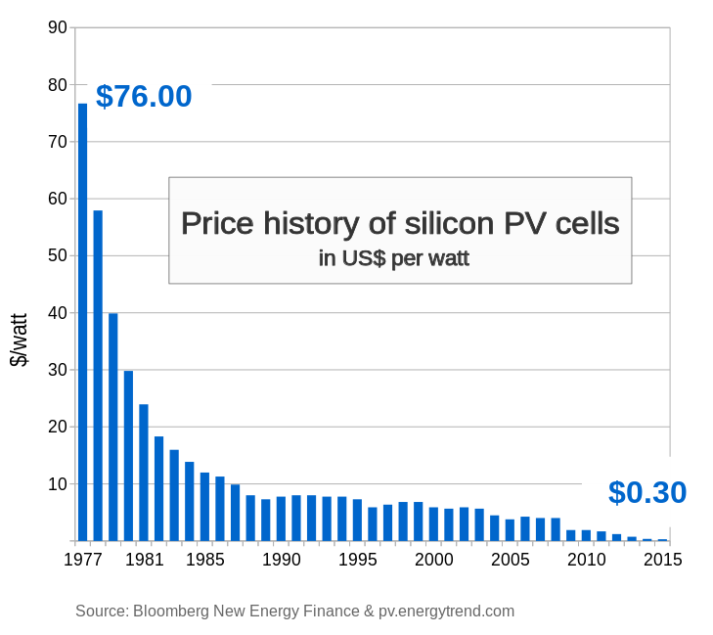
The cost to install solar has plummeted

Slide 33
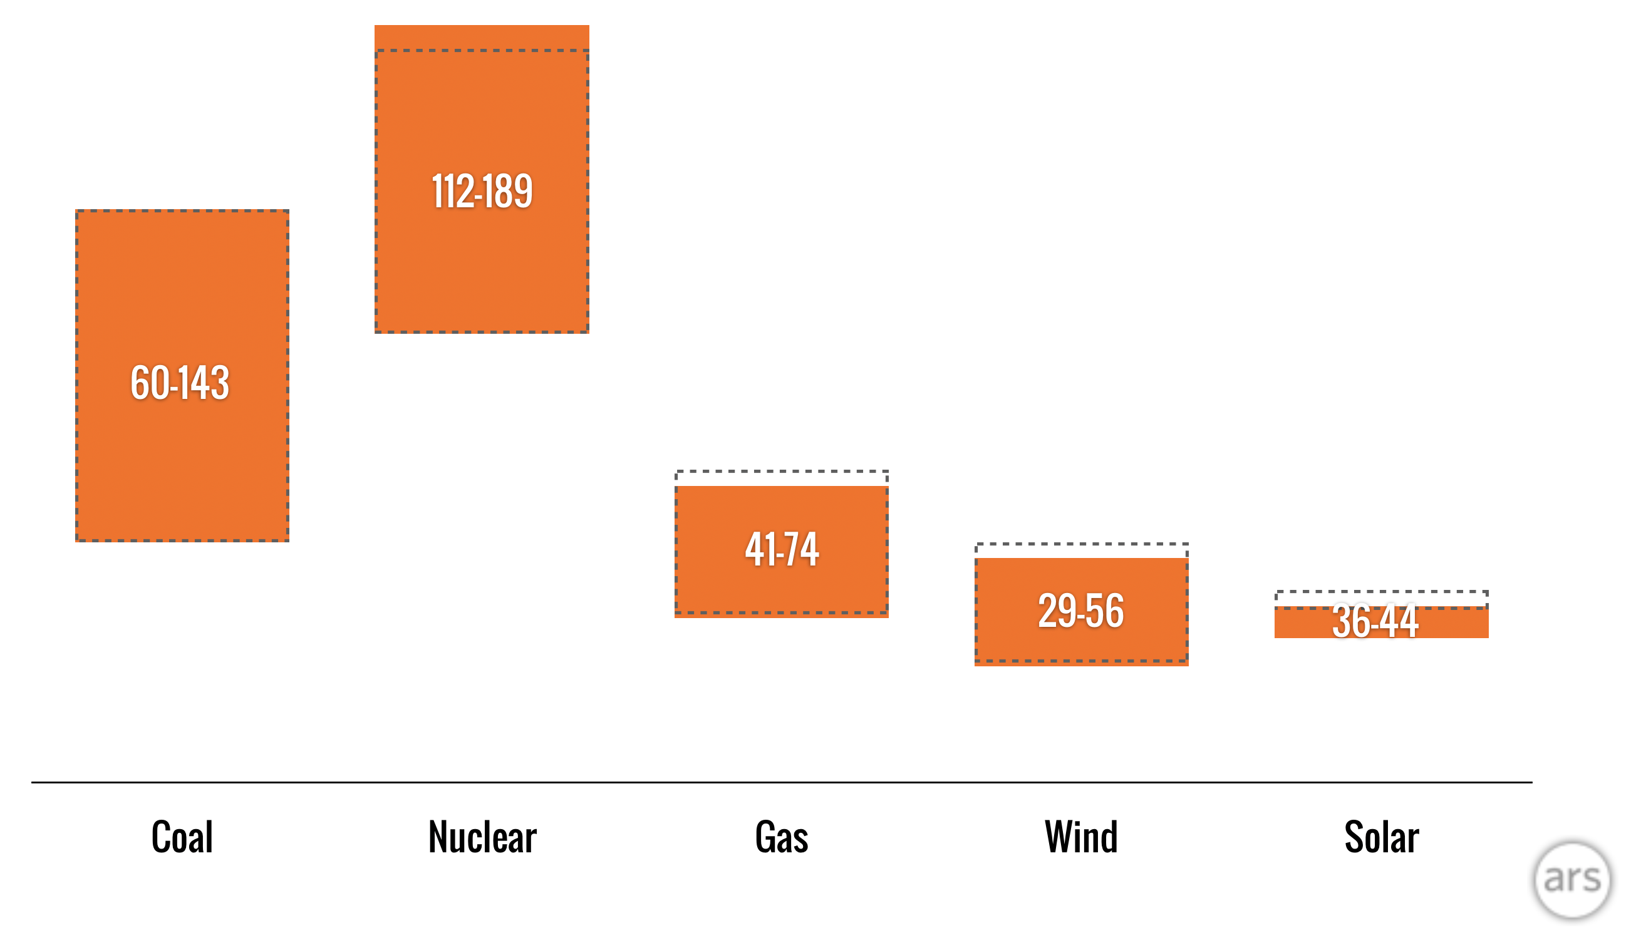
Renewables are cheap!
Costs of new electric power plant installations in dollars per megawatt-hour
2018
2017
Coal Nuclear Gas Wind Solar
https://arstechnica.com/information-technology/2018/11/new-year-same-story-cost-of-wind-and-solar-fall-below-cost-of-coal-and-gas/
Notes:
https://arstechnica.com/information-technology/2018/11/new-year-same-story-cost-of-wind-and-solar-fall-below-cost-of-coal-and-gas/

Slide 34
Your diet matters!
Kilograms of CO₂ equivalent released in production and consumption of 50 grams of protein
Graphic: NY Times
Notes:
Poore, J., Nemecek, T., 2018. Reducing food’s environmental impacts through producers and consumers. Science 360, 987-992.
Graphic: https://www.nytimes.com/interactive/2019/04/30/dining/climate-change-food-eating-habits.html

Slide 35
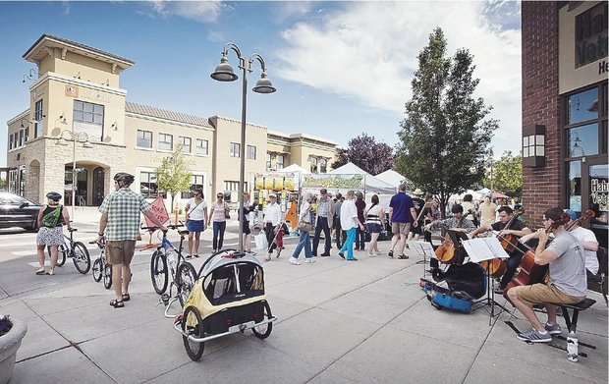
What if we kept our cars parked for trips less than one mile? In the US, each year we would save
$900 million in fuel and maintenance costs
2 million metric tons of CO₂ emissions
Walkable & bikable communities are healthier
and cleaner
https://www.epa.gov/greenvehicles/what-if-we-kept-our-cars-parked-trips-less-one-mile
Notes:
https://www.epa.gov/greenvehicles/what-if-we-kept-our-cars-parked-trips-less-one-mile

Slide 36
What you can do

Slide 37
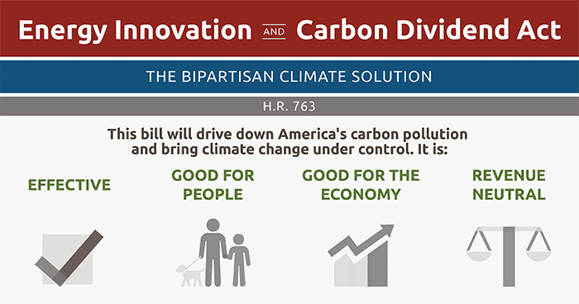

https://citizensclimatelobby.org/energy-innovation-and-carbon-dividend-act/
Notes:
https://citizensclimatelobby.org/energy-innovation-and-carbon-dividend-act/

Slide 38





Paris Climate Conference 2015
Agreement to keep global warming well below 2.0 ºC (3.6 ºF)
Source: COP21 Paris
Image source: www.cop21paris.org/
Notes:
Image source: www.cop21paris.org/

Slide 39
https://www.papowerswitch.com/
Notes:
https://www.papowerswitch.com/

Slide 40
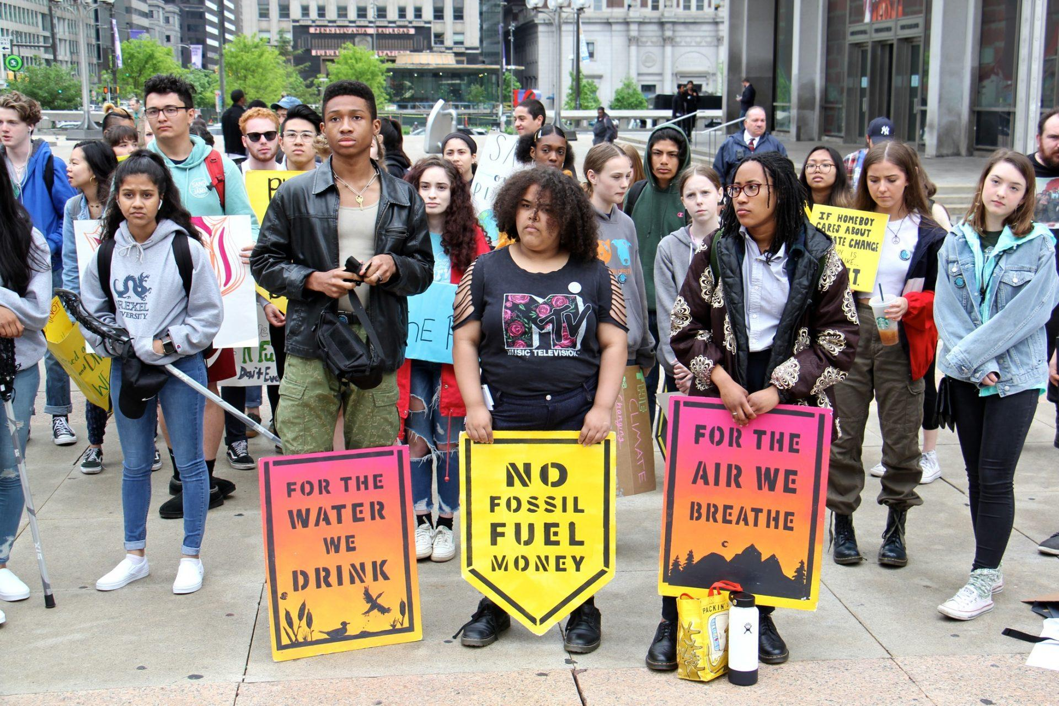
https://www.wesa.fm/post/pa-youth-join-global-student-strike-demand-action-climate-change
Notes:
https://www.wesa.fm/post/pa-youth-join-global-student-strike-demand-action-climate-change

Slide 41
Past environmental successes

Slide 42
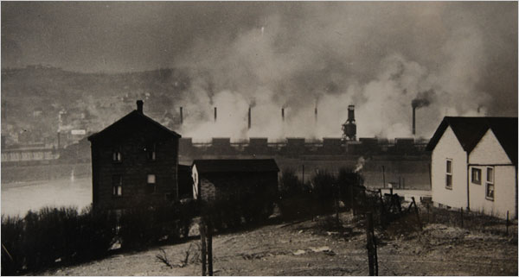
“Smog episodes”
October 1948: Pollution from zinc mills in Donora, PA combined with a temperature inversion, leads to 20 deaths
Source: Donora Smog Museum

Slide 43
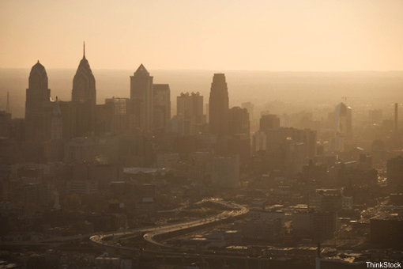
This is happening much less often than it used to because …
Ozone
NO₂
CO
SO₂
Lead
28%
52%
82%
83%
89%
Median change in US: 1980-2010
Data source: www3.epa.gov/airtrends

Slide 44
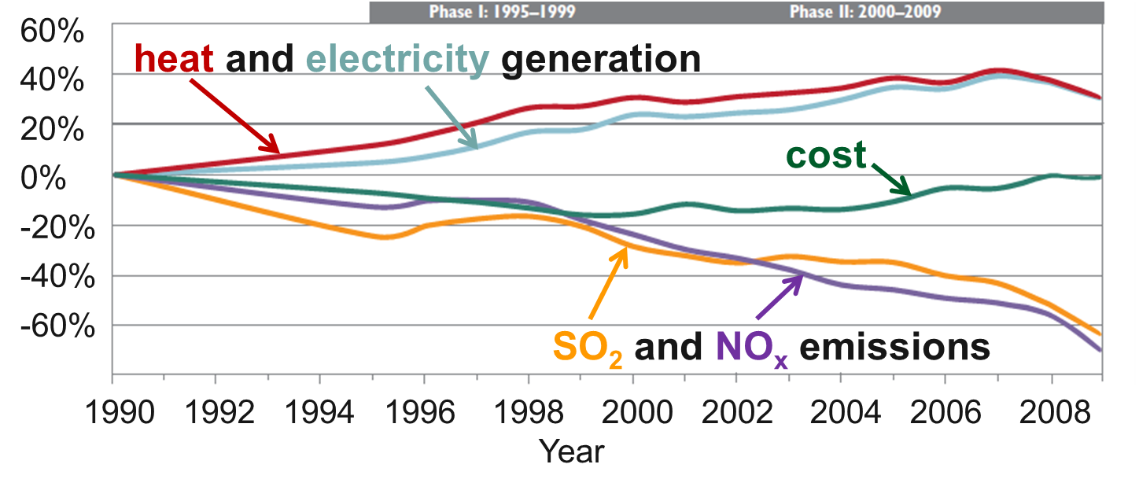
The Clean Air act reduced emissions and created $170 - $430 billion per year in health benefits—all while energy use went up and costs went down!
Burns et al. (2011)
Notes:
Burns, D.A., Baron, J.S., Cosby, B.J., Fenn, M.E., Lynch, J.A., 2011. National Acid Precipitation Assessment Program Report to Congress 2011: An Integrated Assessment. National Science and Technology Council, United States Government, Washington, D.C., 114 pp.

Slide 45
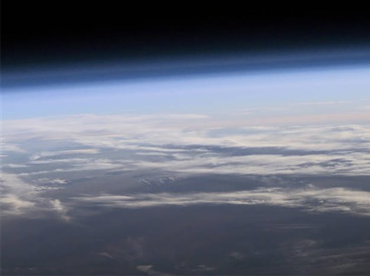
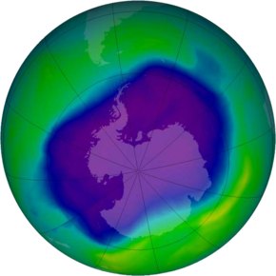
Good news: the ozone hole is shrinking!
https://ozonewatch.gsfc.nasa.gov/statistics/annual_data.html
Notes:
NASA image
https://ozonewatch.gsfc.nasa.gov/statistics/annual_data.html

Slide 46
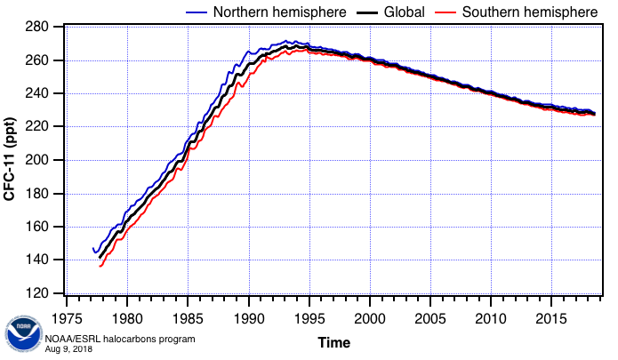
Why? Because levels of (human-produced) chlorofluorcarbons are dropping.
Montreal Protocol adopted
https://www.esrl.noaa.gov/gmd/hats/combined/CFC11.html
Notes:
https://www.esrl.noaa.gov/gmd/hats/combined/CFC11.html

Slide 47
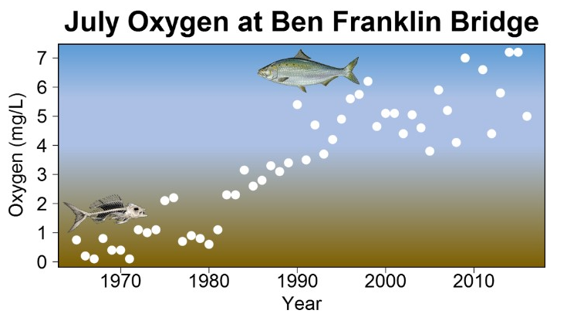
Cleanup of the Delaware River allowed the return of the American Shad
https://www.nj.gov/drbc/edweb/shad-return.html
Notes:
https://www.nj.gov/drbc/edweb/shad-return.html

Slide 48
Take-home messages
The ocean is a moderator of the climate
Anthropogenic CO₂ emissions have negative impacts of the ocean: warming, sea-level rise, and acidification
Human-induced climate change will continue to occur regardless of emissions scenario; further adaptation is necessary
The climate of the mid century and beyond is very sensitive to the emissions scenario
Solutions are at hand
Good science, policy, and business practices have gotten us out of environmental messes before

Slide 49
References
Baumann, H., 2016. Combined Effects of Ocean Acidification, Warming, and Hypoxia on Marine Organisms. Limnology and Oceanography e-Lectures 6, 1-43.
Burns, D.A., Baron, J.S., Cosby, B.J., Fenn, M.E., Lynch, J.A., 2011. National Acid Precipitation Assessment Program Report to Congress 2011: An Integrated Assessment. National Science and Technology Council, United States Government, Washington, D.C., 114 pp.
Church, J.A., White, N.J., Konikow, L.F., Domingues, C.M., Cogley, J.G., Rignot, E., Gregory, J.M., van den Broeke, M.R., Monaghan, A.J., Velicogna, I., 2011. Revisiting the Earth's sea-level and energy budgets from 1961 to 2008. Geophysical Research Letters 38, L18601.
Cooley, S.R., Moore, D.J.P., Alin, S.R., Butman, D., Clow, D.W., French, N.H.F., Feely, R.A., Johnson, Z.I., Keppel-Aleks, G., Lohrenz, S.E., Ocko, I.B., Shadwick, E.H., Sutton, A.J., Potter, C.S., Takatsuka, Y., Walker, A.P., Yu, R.M.S., 2018. Chapter 17: Biogeochemical effects of rising atmospheric carbon dioxide. In: N. Cavallaro, G. Shrestha, R. Birdsey, M. A. Mayes, R. G. Najjar, S. C. Reed, P. Romero-Lankao, and Z. Zhu (Editor), Second State of the Carbon Cycle Report (SOCCR2): A Sustained Assessment Report. U.S. Global Change Research Program, Washington, DC, USA, pp. 690–727.
Poore, J., Nemecek, T., 2018. Reducing food’s environmental impacts through producers and consumers. Science 360, 987-992.
Reynaud S, Leclercq N, Romaine-Lioud S, Ferrier-Pagés C, Jaubert J, Gattuso J-P (2003). Interacting effects of CO₂ partial pressure and temperature on photosynthesis and calcification in a scleractinian coral. Glob Change Biol 9:1660-1668
Sabine, C.L., Feely, R.A., Gruber, N., Key, R.M., Lee, K., Bullister, J.L., Wanninkhof, R., Wong, C., Wallace, D.W., Tilbrook, B., 2004. The oceanic sink for anthropogenic CO₂. Science 305, 367-371.
Schmitt, R.W. 2018. The ocean’s role in climate. Oceanography 31(2):32–40, https://doi.org/10.5670/oceanog.2018.225 .

