Slide 1
Five actions on climate change
Raymond Najjar
Good Shepherd Catholic Church
January 24, 2016

Slide 2
1. Remind yourself and others of past successes
We have solved big environmental problems before
Just a few past successes: dramatic improvements in
U.S. air quality (Clean Air Act)
U.S. water quality (Clean Water Act)
Ozone layer (Montreal Protocol)

Slide 3
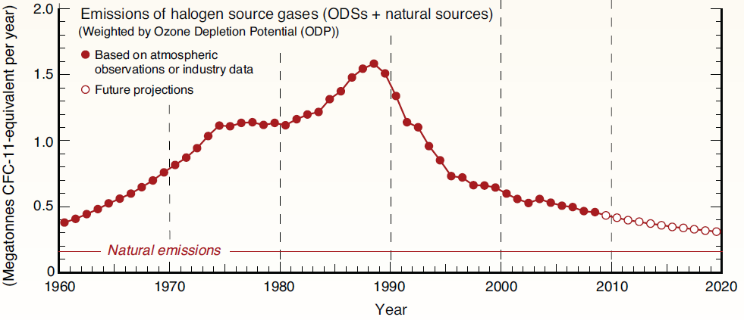
Emissions of CFCs and other ozone-depleting substances (ODSs)
1987: Montreal Protocol
1974: CFC ozone depletion hypothesis

Slide 4
2. Don’t be discouraged by contrarians
Global warming is real, it’s serious, it’s us, and we can do something about it
There are persistent efforts to cast doubt on solid science (read/see “Merchants of Doubt”)

Slide 5
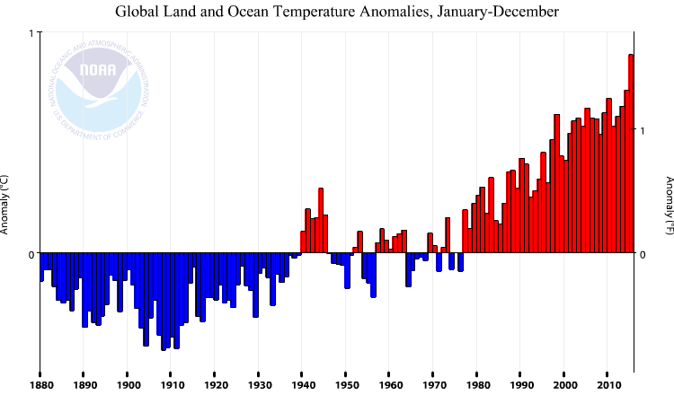
Earth’s mean temperature change over the past 135 years
1 ºC
2015 was the warmest year on record by a large margin
1 ºF
0 ºC
0 ºF

Slide 6
3. Support international climate treaties
This is a global problem and needs global solutions
The developed and undeveloped world need to be involved in solutions
The recent Paris conference was a critical step in the right direction

Slide 7
Paris Climate Conference 2015 (COP21)
21st session of the Conference of the Parties to the United Nations Framework Convention on Climate Change
Source: COP21 Paris
Notes:
Image source: www.cop21paris.org/

Slide 8
Paris Climate Conference 2015 (COP21)
PARIS
2015
A United Nations conference that was held November 30th - December 11th, 2015 in Paris
First ever worldwide commitment to combat climate change by phasing out the use of fossil fuels over time
195 nations agreed to keep global warming “well below” 2.0 ºC (3.6 ºF) and “endeavor to limit” warming to an even lower, 1.5 ºC
Source: Embassy of France in Wellington
Notes:
Image source (awaiting approval): http://www.ambafrance-nz.org/2015-Paris-Climate-Conference

Slide 9
More key points:
Participating countries will re-submit mitigation plans every five years in order to tighten emissions standards
Between 2050 - 2100, global emissions shall be reduced to the same amount that can be naturally absorbed via carbon sinks such as trees, oceans, and soil
Wealthy developed nations will provide “climate finance” to developing countries in order to help them switch to renewable energy and deal with climate impacts
Source: COP21 Paris.org
Notes:
Image from www.logo-kid.com & cop21paris.org

Slide 10
4. Support national efforts to reduce greenhouse gas emissions
Three examples:
The Clean Power Plan
Efficiency standards for cars and appliances
A tax on carbon or a cap on emissions (see Citizen’s Climate Lobby; State College Chapter Leader is Sylvia Neely, sneelypa@gmail.com)

Slide 11
5. Reduce your carbon emissions at home and in daily life
My two favorites:
Get an energy audit to guide home energy improvements—saves money and energy
Purchase electricity from renewable sources; prices are very competitive. Go to papowerswitch.com

Slide 12
Interfaith Power and Light
A great resource on climate change action
A national organization
PA details
paipl.org, PA-IPL on Facebook
Program Director: Cricket Eccleston Hunter, chunter@paipl.org, 814-404-3534

